Slide 1
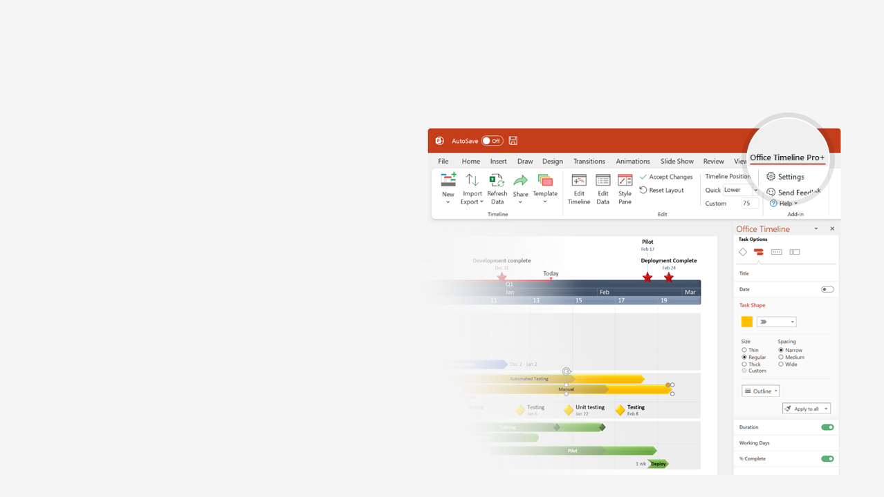

How to update this template in seconds
The Office Timeline add-in for PowerPoint will help you edit it with just a few clicks.
Get your free 14-day trial of Office Timeline here:
https://www.officetimeline.com/office-timeline/14-days-trial
Re-open this template, and create your impressive
PowerPoint visual in 3 easy steps:
1
Click the Edit Data button on the Office Timeline tab.
2
Use the Data and Timeline views to edit swimlanes, milestones and tasks.
3
Click Save to instantly update the template.

Slide 2
Project Planning
8 days
Project Objectives
Jun 3 - Jun 12
8 days
Detailed Reqs.
Jun 11 - Jun 22
4 days
Hardware Reqs.
Jun 11 - Jun 16
Implementation Kick-Off
Staffing Plan
Testing
Implementation
Jun 2
Jun 16
Jul 6
Jul 30
2020
Jun
Jul
2020
Today
Jun 11
Jun 28
Final Resource Plan
Development Completed
12 days
Migration
Jun 4 - Jun 21
10 days
DB Backup
Jun 11 - Jun 24
8 days
Front End Development
Jun 17 - Jun 28
5 days
Mobile Client
Jun 25 - Jul 1
14 days
Prepare Environment
Jun 30 - Jul 18
10 days
System Configuration
Jul 18 - Jul 31

