Slide 1
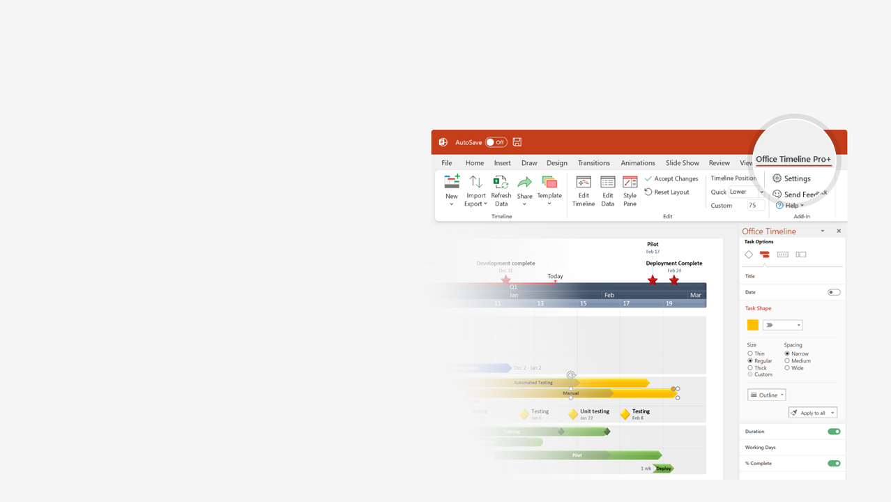

How to update this template in seconds
The Office Timeline add-in for PowerPoint will help you edit it with just a few clicks.
Get your free 14-day trial of Office Timeline here:
https://www.officetimeline.com/14-days-trial
Re-open this template, and create your impressive
PowerPoint visual in 3 easy steps:
1
Click the Edit Data button on the Office Timeline tab.
2
Use the Data and Timeline views to edit swimlanes, milestones and tasks.
3
Click Save to instantly update the template.

Slide 2
Aug 15 - Dec 22
May 10 - Aug 1
Jan 5 - May 20
60 days
94 days
97 days
2023
2024
Today
Project Review Template
Review/Highlight Report:
Project Name:
Reporting Period: |  | Project Manager: |  | Sponsor/Client:
Created by: |  | Date Created: |  | RAG Status: | ■ | Project Phase:
Project Description: |  |  |  | Completion Date:
RAG:  major issues  minor issues  no issues
Kick Off
Milestone 1
Milestone 2
Milestone 3
Milestone 4
Milestone 5
Milestone 6
Milestone 7
Sign Off
May 8
Jun 16
Jul 21
Sep 20
Oct 30
Jan 30
Mar 1
Mar 30
May 30
Q2
Q3
Q4
Q1
Q2
May
Jul
Sep
Nov
Jan
Mar
May
Aug 1
Dec 22
May 20
Checkpoint A
Checkpoint B
Checkpoint C
Phase 1
Phase 2
Phase 3
Milestones, Tasks, Outcomes Delivered This Period | Outstanding Deliverables | Delivery Date | Scheduled Deliverables | Delivery Date
Risk Description | Status/Action | Issue Description | Status/Action | Proposed Change | Approved
Financial Reporting
Capital |  |  |  |  | Revenue |  |  |  |  | External
Source | Budget | Actual | Remaining | Forecast | Source | Budget | Actual | Remaining | Forecast | Source | Budget | Actual | Remaining | Forecast

