Slide 1
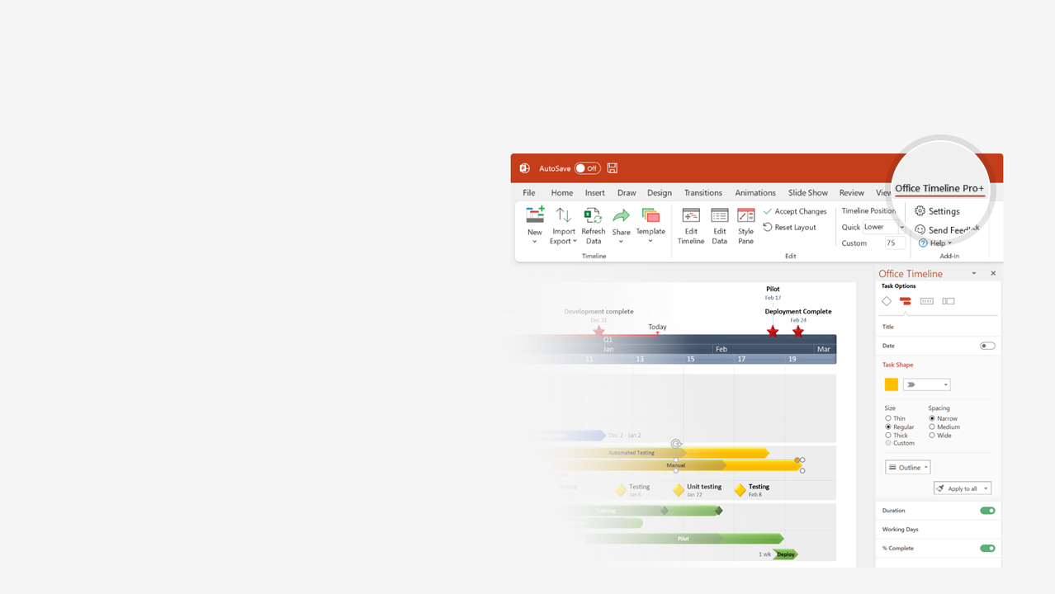

How to update this template in seconds
The Office Timeline add-in for PowerPoint will help you edit it with just a few clicks.
Get your free 14-day trial of Office Timeline here: https://www.officetimeline.com/office-timeline/14-days-trial Re-open this template, and create your impressive PowerPoint visual in 3 easy steps:
1
Click the Edit Data button on the Office Timeline tab.
2
Use the Data and Timeline views to edit swimlanes, milestones and tasks.
3
Click Save to instantly update the template.

Slide 2
Apr 13
Jan 13
Jul 13
Oct 13
Oct 13
Jul 13
Apr 13
Jul 13
Jan 13
Apr 13
Jul 13
Oct 13
Apr 13
Jul 13
Jan 13
Oct 13
Jul 13
Jul 13
Apr 13
Jan 13
Oct 13
Jan 13
Apr 13
Oct 13
Oct 13
Apr 13
Jul 13
Oct 13
Apr 13
Jul 13
Apr 13
Oct 13
2025
2025
Project roadmap template
Today
Q1
Q2
Q3
Q4
Website Design & Dev
Optimize for Mobile
ECommerce Dev
ECommerce Update
Website
Purchase Flow
Rebrand Update
Funnel Optimization
Blog Design Update
SEO Audit
SEO Optimization
Social Media Campaign
SEO Review
SEO/SEM
SEM Audit
SEM Campaign
Blog Campaign
SEM Review
Brand Change
Facebook Ads
Bing Ads
3rd Party Lead Gen
Youtube Ads
Ads
Google Ads
Display Ads Creative
Mobile Ads
Email Ads
DevOps
Geo-replication
Access Firewall Integration
Disaster Recovery Testing
Security Audit
Testing
Automated Test Framework
Automated Testing
Automated Testing

