Slide 1
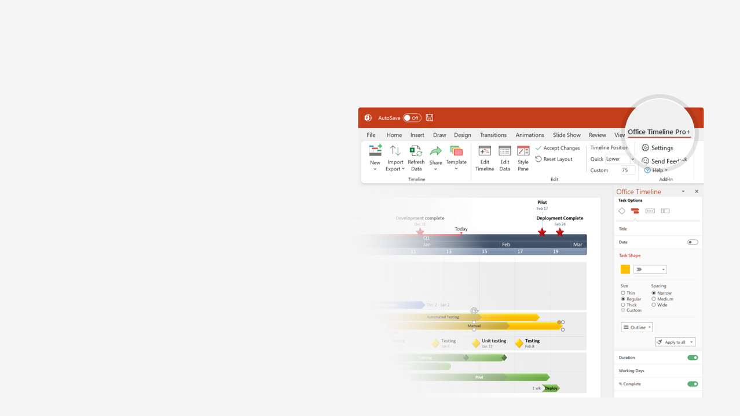

How to update this template in seconds
The Office Timeline add-in for PowerPoint will help you edit it with just a few clicks.
Get your free 14-day trial of Office Timeline here: https://www.officetimeline.com/14-days-trial Re-open this template, and create your impressive PowerPoint visual in 3 easy steps:
1
Click the Edit Data button on the Office Timeline tab.
2
Use the Data and Timeline views to edit swimlanes, milestones and tasks.
3
Click Save to instantly update the template.

Slide 2
Total Planned Hours: | 315 | Hours used
Total Actual Hours: | 308
Hours Remaining: | 7
Project Schedule
Kick Off
Milestone
Milestone
Milestone
Sign Off
Mar 27
Apr 3
Apr 15
May 1
May 18
PROJECT OWNER:
[Enter Name]
Mon
Sat
Thu
Tue
Sun
Fri
Wed
Mon
Sat
Thu
Tue
27/03
01/04
06/04
11/04
16/04
21/04
26/04
01/05
06/05
11/05
16/05
Planned hours
16 h
16 h
40 h
Planned hours: | 72
Actual hours: | 62
Preparing Plans
PP1
PP2
PP3
Actual hours
12 h
16 h
34 h
1
2
3
70%
40%
10%
Planned hours
20 h
15 h
40 h
16 h
Planned hours: | 91
Actual hours: | 98
Preparing Site Design
PD1
PD2
PD3
PD4
Actual hours
30 h
12 h
44 h
12 h
1
2
3
4
70%
50%
30%
20%
Planned hours
24 h
72 h
16 h
Planned hours: | 112
Actual hours: | 114
Phase 1
P1T1
P1T2
P1T3
Actual hours
32 h
68 h
14 h
1
2
3
30%
45%
90%
Planned hours
16 h
24 h
Planned hours: | 40
Actual hours: | 34
Phase 2
P2T1
P2T2
Actual hours
11 h
24 h
1
2
10%
20%

