Slide 1
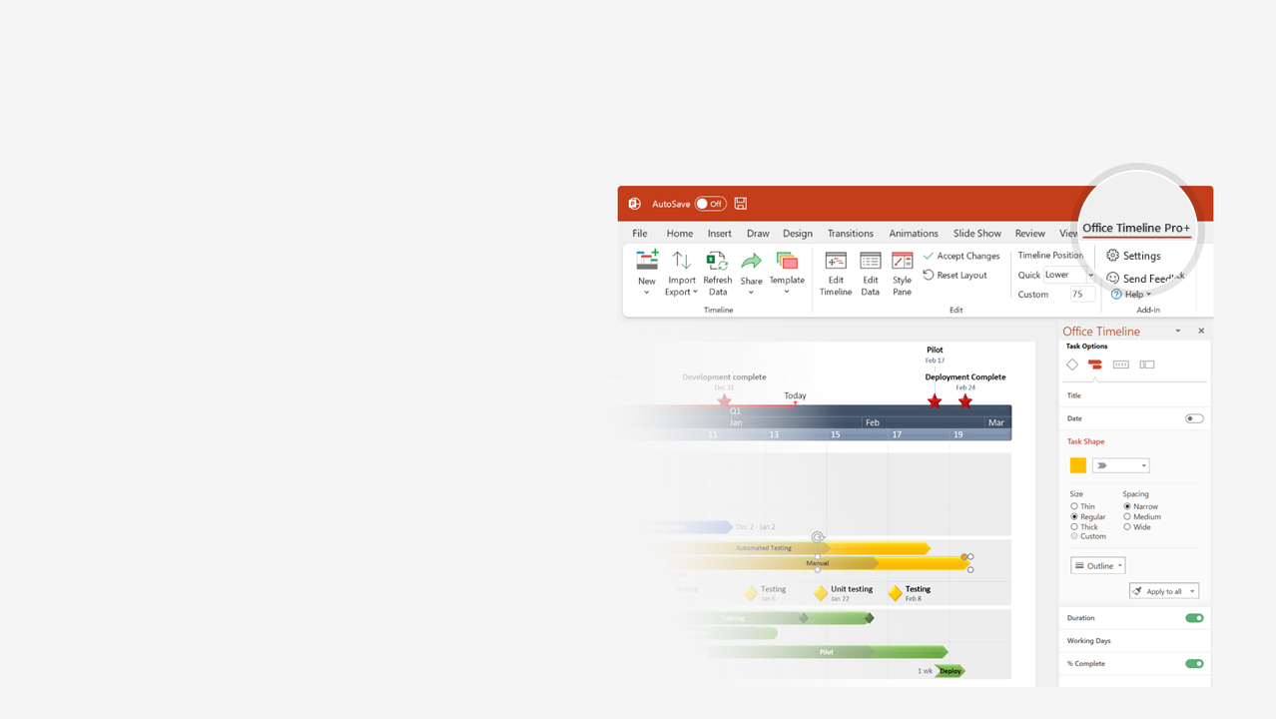

How to update this template in seconds
The Office Timeline add-in for PowerPoint will help you edit it with just a few clicks.
Get your free 14-day trial of Office Timeline here: https://www.officetimeline.com/14-days-trial Re-open this template, and create your impressive PowerPoint visual in 3 easy steps:
1
Click the Edit Data button on the Office Timeline tab.
2
Use the Data and Timeline views to edit swimlanes, milestones and tasks.
3
Click Save to instantly update the template.

Slide 2
Project Status Report
Project Title: |  | Project Manager: |  | Overall RAG Status: | ■ |  | ■ = major issues
Reporting Period: |  | Sponsor/Client: |  | Issues: |  |  | ■ = minor issues
Progress Report: |  | Completion Date: |  |  |  |  | ■ = no issues
Kick Off
Milestone 1
Milestone 2
Milestone 3
Milestone 4
Milestone 5
Milestone 6
Milestone 7
Sign Off
May 8
Jun 16
Jul 21
Sep 20
Oct 30
Jan 30
Mar 1
Mar 30
May 30
Q2
Q3
Q4
Q1
Q2
May
Jul
Sep
Nov
Jan
Mar
May
Aug 1
Dec 22
May 20
Checkpoint A
Checkpoint B
Checkpoint C
Phase 1
Phase 2
Phase 3
Milestones, Tasks, Outcomes delivered | Comments | Milestones, Tasks, Outcomes to be delivered | Comments | Completion Dates
 |  |  |  | Planned | Actual
Recommendations and Requests for Decision or Support:

