Slide 1
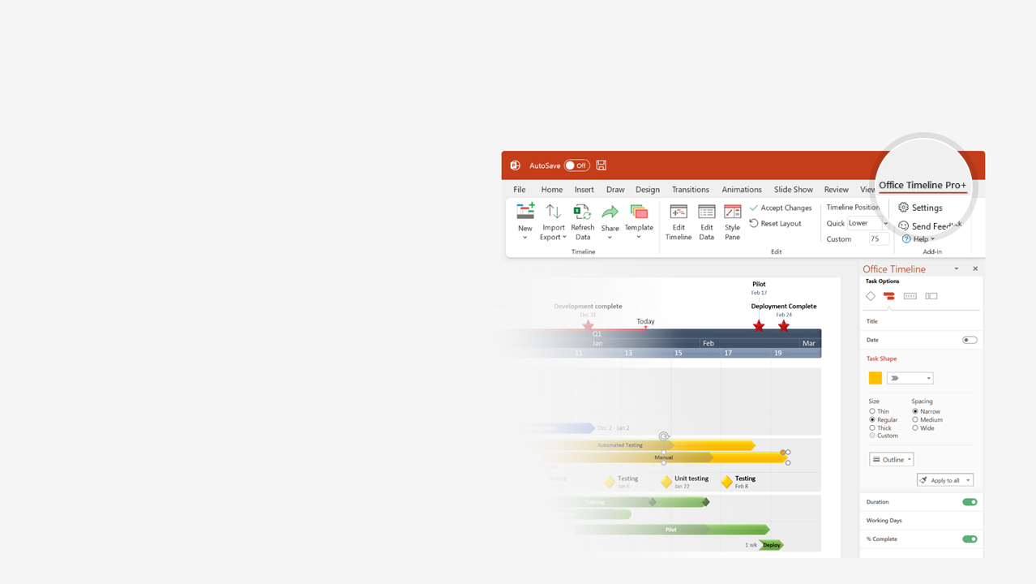

How to update this template in seconds
The Office Timeline add-in for PowerPoint will help you edit it with just a few clicks.
Get your free 14-day trial of Office Timeline here:
https://www.officetimeline.com/office-timeline/14-days-trial
Re-open this template, and create your impressive
PowerPoint visual in 3 easy steps:
1
Click the Edit Data button on the Office Timeline tab.
2
Use the Data and Timeline views to edit swimlanes, milestones and tasks.
3
Click Save to instantly update the template.

Slide 2

260 days
225 days
119 days
Mar 11
Apr 15
Apr 10
Dec 24
Jul 10
Aug 26
Oct 26
Sep 27
Jun 15
Feb 5
Jul 3
Oct 4
Mar 7
2021
2023
Project Chart template
Milestone 8
Milestone 13
2021
2022
2023
Q4
Q1
Q2
Q3
Q4
Q1
Q2
Q3
Q4
Oct
Jan
Apr
Jul
Oct
Jan
Apr
Jul
Oct
Today
Milestone 4
Oct 30
Task 1
Oct 28
Phase I
Milestone 2
Milestone 1
Milestone 3
Milestone 9
Phase II
Nov 15
Task 2
Sep 25
Milestone 5
Milestone 6
Milestone 7
Jun 11
Task 3
Nov 23
Phase III
Milestone 11
Milestone 10
Milestone 12

