Slide 1
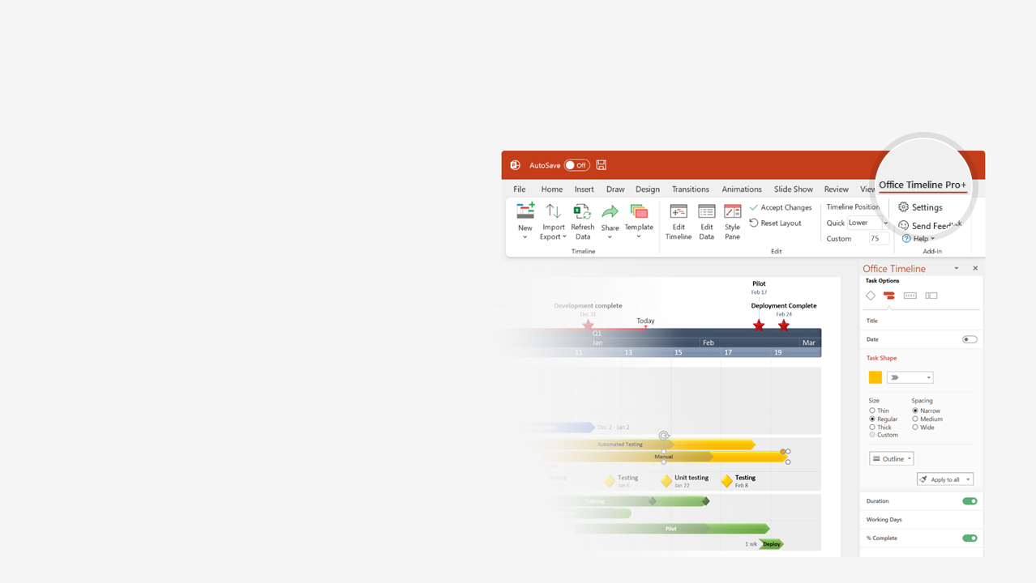

How to update this template in seconds
The Office Timeline add-in for PowerPoint will help you edit it with just a few clicks.
Get your free 14-day trial of Office Timeline here: https://www.officetimeline.com/14-days-trial Re-open this template, and create your impressive PowerPoint visual in 3 easy steps:
1
Click the Edit Data button on the Office Timeline tab.
2
Use the Data and Timeline views to edit swimlanes, milestones and tasks.
3
Click Save to instantly update the template.

Slide 2
85 days
19 days
27 days
54 days
48 days
50 days
90 days
35 days
35 days
50 days
53 days
52 days
61 days
2023
2023
Today
Project Tracker
Q1
Q2
Q3
Jan
23 days
Feb
Mar
36 days
Apr
May
Jun
Jul
Aug
Sep
01
09
20
28
06
15
23
25 days
28 days
PROJECT OWNER:
[Enter Name]
Milestone
Category A
Milestone
Category B
Start
51 days
End
Jan 1
51 days
Apr 10
May 10
Sep 21
Task 1
100%
Task 3
100%
Dan
23/1 - 23/2
23/3 - 23/5
Task 1
100%
Task 3
100%
Category A
23/1 - 23/2
23/3 - 23/4
 | Planned
 | Actual
Alice
23/2 - 23/4
Task 2
100%
23/1 - 23/4
Task 2
100%
Tom
2/23 - 5/23
Task 4
100%
5/23 - 6/23
Task 5
100%
Category B
2/23 - 5/23
Task 4
100%
5/23 - 7/23
Task 5
45%
 | Planned
 | Actual
Jamie
5/23 - 6/23
Task 6
100%
5/23 - 6/23
Task 6
65%
03/20 - 06/05
Task 7
100%
Task 8
45%
Joan
06/17 - 08/26
03/10 - 06/02
Task 7
100%
56 days
Task 8
45%
06/19 - 08/30
25%
Task 9
 | Planned
 | Actual
Category C
Mark
07/12 - 09/21
25%
Task 9
07/10 - 09/21
Liz
03/03 - 07/06
Task 10
85%
03/10 - 07/06
Task 10
85%

