Slide 1
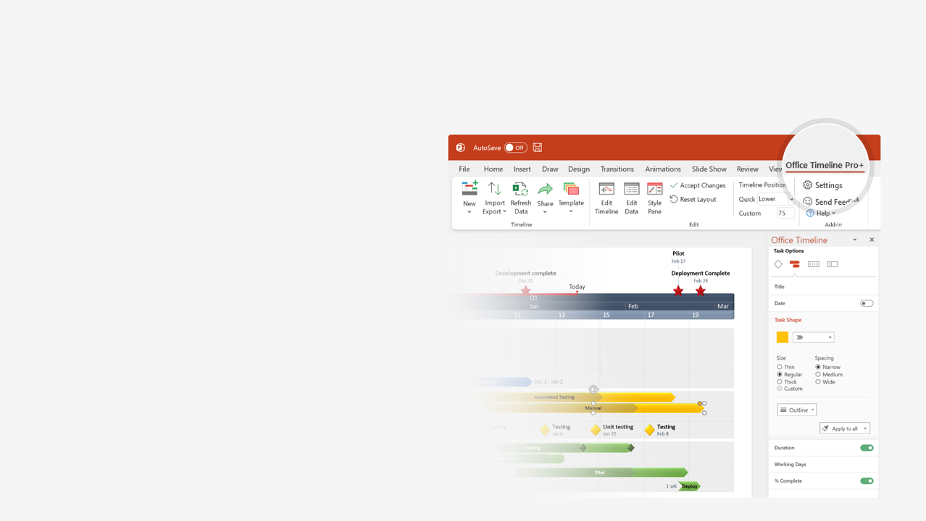
How to update this template in seconds
The Office Timeline add-in for PowerPoint will help you edit it with just a few clicks.
Get your free 14-day trial of Office Timeline here: https://www.officetimeline.com/14-days-trial Re-open this template, and create your impressive PowerPoint visual in 3 easy steps:
1
Click the Edit Data button on the Office Timeline tab.
2
Use the Data and Timeline views to edit swimlanes, milestones and tasks.
3
Click Save to instantly update the template.

Slide 2
RACI matrix
Task | Marketing Manager | Graphic Designer | Content Creator | Campaign Analyst | Web Developer
Set objectives and strategy | Responsible | Accountable | Consulted | Informed
Target audience | Accountable | Responsible | Consulted | Informed
Content and design input | Consulted | Informed | Responsible | Accountable
Execution | Informed | Consulted | Accountable |  | Responsible
Implementation | Accountable | Informed | Consulted |  | Responsible
Project roadmap
Q4
Q1
Oct
Nov
Dec
Jan
Feb
Mar
Week 1
3
5
7
9
11
13
15
17
19
21
Objectives Approved
Audience Approved
Implementation Complete
Set objectives and strategy
Review and approve objectives
Marketing Manager (R)
Graphic Designer (A)
Content Creator (C) Campaign Analyst (I)
Develop campaign objectives
Provide input on visual & messaging
Identify target audience
Review and approve audience
Graphic Designer (R)
Marketing Manager (A)
Content Creator (C) Campaign Analyst (I)
Planning
Target audience
Develop key messaging
Align visuals and content with target
Content and design input
Content requirements & design elements
Content Creator (R)
Campaign Analyst (A)
Marketing Manager (C) Graphic Designer (I)
Create visuals & messaging
Review and approve content & design input
Coordination
Monitor execution
Marketing Manager (I;A)
Content Creator (A;C)
Graphic Designer (C;I) Web Developer (R;R)
Execution
Coordinate implementation
Implementation

