Slide 1
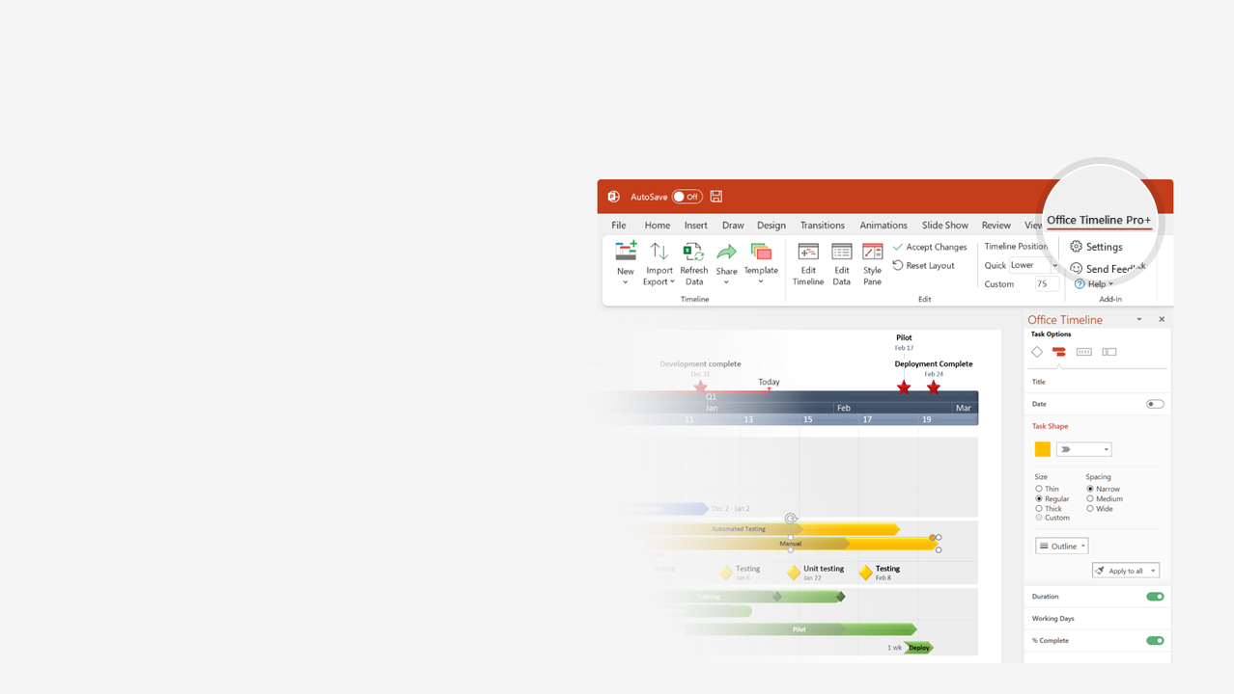

How to update this template in seconds
The Office Timeline add-in for PowerPoint will help you edit it with just a few clicks.
Get your free 14-day trial of Office Timeline here:
https://www.officetimeline.com/office-timeline/14-days-trial
Re-open this template, and create your impressive
PowerPoint visual in 3 easy steps:
1
Click the Edit Data button on the Office Timeline tab.
2
Use the Data and Timeline views to edit swimlanes, milestones and tasks.
3
Click Save to instantly update the template.

Slide 2
Simple Gantt Chart
Integration into learning system
Nov 15 - Nov 28
Acceptance review
Nov 10 - Nov 13
Collect testing results
Oct 25 - Oct 26
Testing
Oct 10 - Oct 25
Translate content
Oct 13 - Oct 17
Revise content
Sep 23 - Sep 24
Edit footage
Sep 18 - Sep 22
Create video footage
Sep 12 - Sep 20
Script review
Aug 10 - Aug 15
Write script
Aug 1 - Aug 12
Plan course
Jul 16 - Jul 28
Course objectives
Jul 14 - Jul 15
Kick-off
Script approved
Launch
Jul 10
Aug 25
Nov 30
2021
Jul
Aug
Sep
Oct
Nov
Jul 30
Oct 17
Course plan approved
Translation complete

