Slide 1
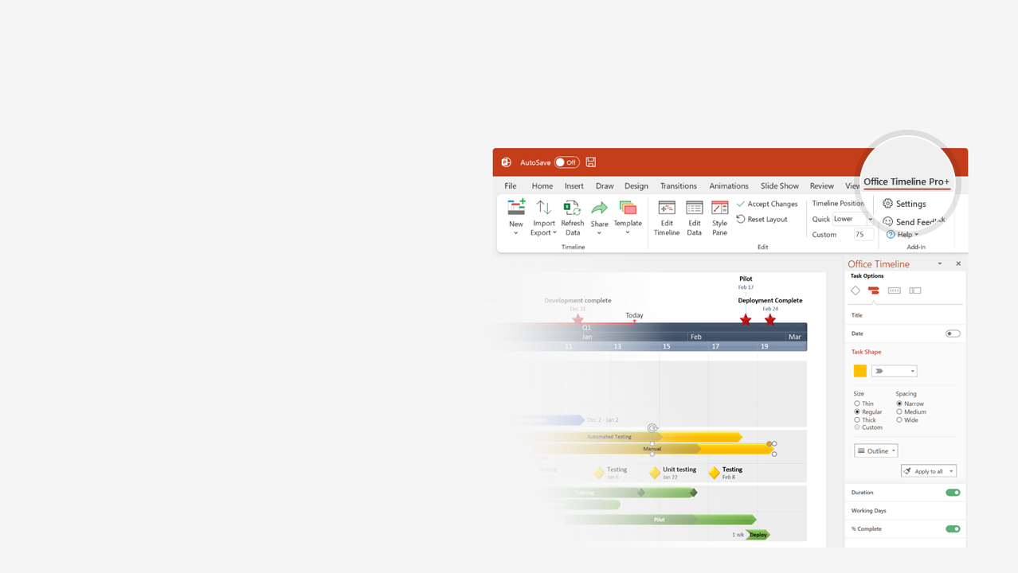

How to update this template in seconds
The Office Timeline add-in for PowerPoint will help you edit it with just a few clicks.
Get your free 14-day trial of Office Timeline here:
https://www.officetimeline.com/office-timeline/14-days-trial
Re-open this template, and create your impressive
PowerPoint visual in 3 easy steps:
1
Click the Edit Data button on the Office Timeline tab.
2
Use the Data and Timeline views to edit swimlanes, milestones and tasks.
3
Click Save to instantly update the template.

Slide 2
Software Development Gantt chart
PC Image Analysis
3 days
PC Image Preparation
6 days
Smartphone Image Preparation
5 days
Optimization
3 days
PC Image Test
5 days
Smartphone Test
5 days
PC Image Sign-Off
6 days
Smartphone Image Sign-Off
5 days
Documentation
2 days
Helpdesk Training
3 days
Production
Day 1
6
11
16
21
26
31
36
41
46
51
56
Today
Image Rolled Out
Image Approved
Project Approval
Project Hand-Off

