Slide 1
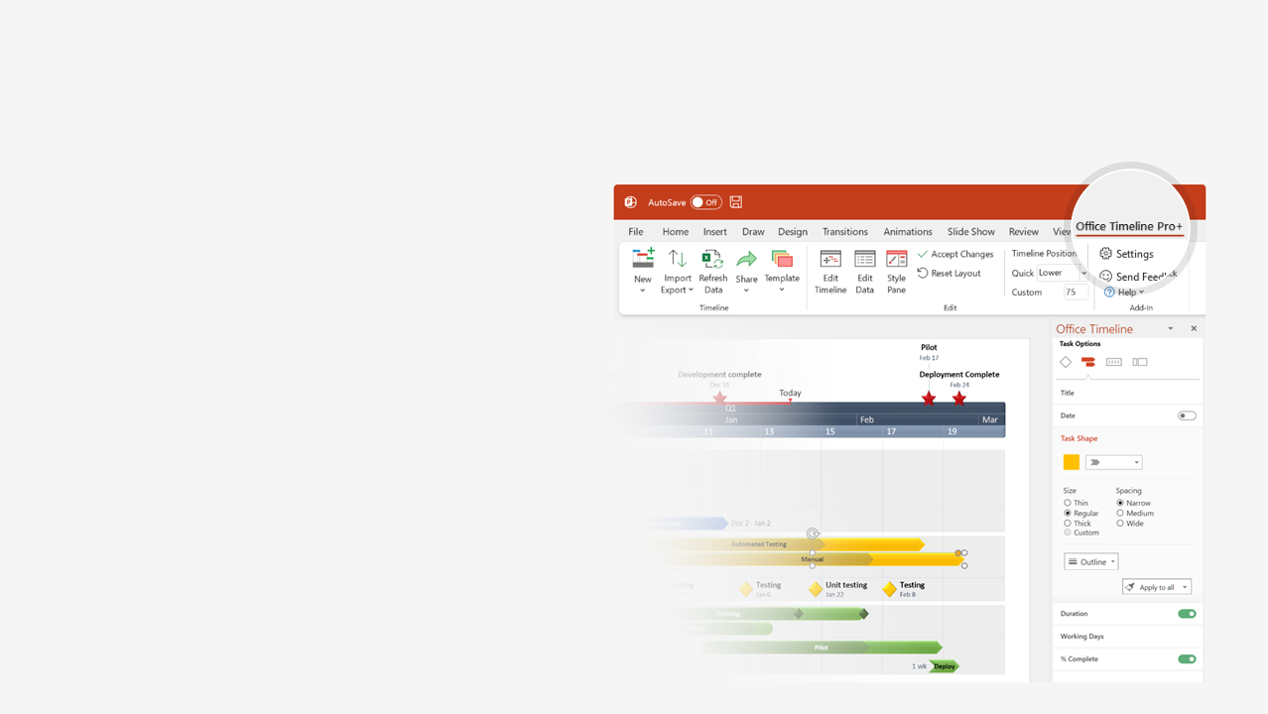
How to update this template in seconds
The Office Timeline add-in for PowerPoint will help you edit it with just a few clicks.
Get your free 14-day trial of Office Timeline here: https://www.officetimeline.com/14-days-trial Re-open this template, and create your impressive PowerPoint visual in 3 easy steps:
1
Click the Edit Data button on the Office Timeline tab.
2
Use the Data and Timeline views to edit swimlanes, milestones and tasks.
3
Click Save to instantly update the template.

Slide 2
1st Starlink internet satellites launched into orbit
SpaceX timeline
May 23, 2019
1st all private civilian crew in orbit (Inspiration4)
Falcon Heavy launched into solar orbit
1st satellite launched into geosynchronous orbit
Sep 15, 2021
Feb 6, 2018
1st orbital test flight trial on the Starship (failed)
Today
2002
Dec 3, 2013
Launches, orbits and recovers spacecraft
1st vertical landing on an ocean platform
Nov 18, 2023
2025
Elon Musk founds SpaceX
100th launch
May 6, 2002
Dec 9, 2010
Apr 8, 2016
Aug 18, 2020
2002
2004
2006
2008
2010
2012
2014
2016
2018
2020
2022
2024
May 25, 2012
Sep 6, 2017
Mar 14, 2024
1st spacecraft sent to ISS
Unveils largest rocket in history
3rd Starship test flight goes further than ever
Sep 28, 2008
1st rocket to reach orbit
Dec 22, 2015
Apr 8, 2022
1st propulsive landing on land
1st all-private mission to the ISS
Nov 15, 2020
1st fully operational mission (Crew Dragon)
Jun 30, 2020
1st SpaceX astronaut launch

