Slide 1
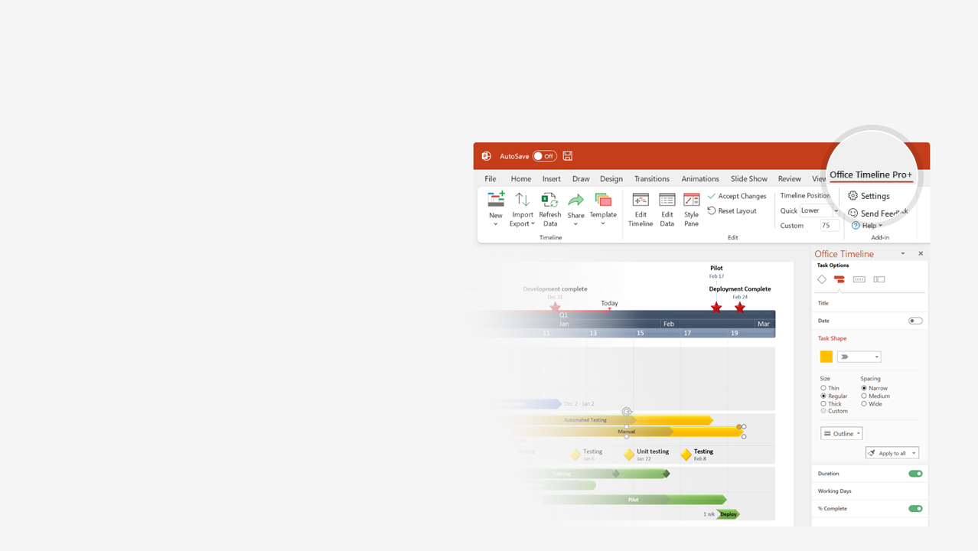

How to update this template in seconds
The Office Timeline add-in for PowerPoint will help you edit it with just a few clicks.
Get your free 14-day trial of Office Timeline here:
https://www.officetimeline.com/14-days-trial
Re-open this template, and create your impressive
PowerPoint visual in 3 easy steps:
1
Click the Edit Data button on the Office Timeline tab.
2
Use the Data and Timeline views to edit swimlanes, milestones and tasks.
3
Click Save to instantly update the template.

Slide 2
Sprint Project Tracker
20 days
20 days
Phase 1
Phase 2
As planned
Sprint 1 – Done
Sprint 2 – Done
Sprint 3 – In progress
Sprint 4 – Not Started
At risk
100%
100%
90%
Jun 5 - Jun 16
Jun 19 - Jun 30
Jul 3 - Jul 14
Jul 17 - Jul 28
Jun
Jul
Aug
Week 1
2
3
4
5
6
7
8
9
05/06
12/06
19/06
26/06
03/07
10/07
17/07
24/07
31/07
Item 1
Review Sprint 1
100%
Jun 16
Sprint 1
Item 2
100%
PHASE 1
Item 3
100%
Item 1
100%
Review Sprint 2
Sprint 2
Jun 30
Item 2
100%
Item 3
100%
Item 1
100%
Review Sprint 3
Sprint 3
Jul 14
Item 2
80%
PHASE 2
Item 3
90%
Item 1
Review Sprint 4
Sprint 4
Jul 28
Item 2
Item 3

