Slide 1
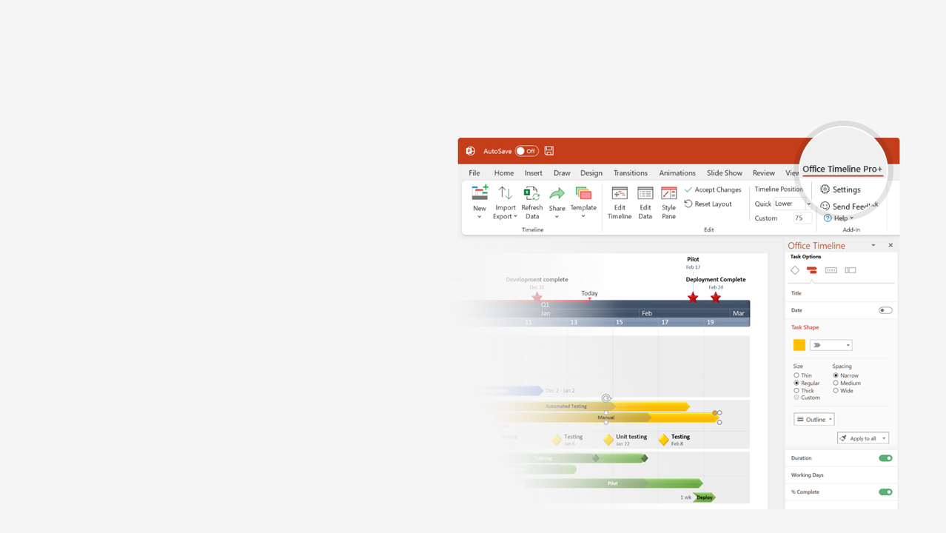

How to update this template in seconds
The Office Timeline add-in for PowerPoint will help you edit it with just a few clicks.
Get your free 14-day trial of Office Timeline here: https://www.officetimeline.com/office-timeline/14-days-trial Re-open this template, and create your impressive PowerPoint visual in 3 easy steps:
1
Click the Edit Data button on the Office Timeline tab.
2
Use the Data and Timeline views to edit swimlanes, milestones and tasks.
3
Click Save to instantly update the template.

Slide 2
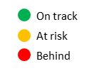
Aug 11 - Jul 22
Mar 25 - Jun 15
Nov 25 - Feb 13
Dec 25 - Feb 18
Aug 27 - Sep 22
Sep 24 - Nov 18
Oct 1 - Aug 11
Oct 1 - Jul 22
Jan 8 - Mar 24
Jun 15 - Sep 3
Sep 5 - Nov 23
Feb 14 - May 3
May 4 - Jul 21
Dec 1 - Dec 23
Mar 6 - Apr 24
Feb 29, 2020
Jul 16, 2021
Oct 15, 2020
472.8 days
Oct 1 - Jan 7
169.9 days
118.6 days
173.3 days
Activity
Activity
54.2 days
58.1 days
57.5 days
56.7 days
18.9 days
71 days
58 days
56 days
56 days
16 days
40 days
40 days
35 days
Dec 19
Oct 15
Jan 18
Apr 27
Mar 24
Jun 15
Jan 30
Apr 1
Jul 8
2019
Today
2021
Strategy Map Scorecard Template
COMPANY NAME
ADDRESS
CITY
STATE
ZIP
FINANCIAL
CUSTOMER
INTERNAL PROCESSES
LEARNING & GROWTH
Objective
Objective
Objective
Initiative
Sep 10 - May 5
100%
Objective
Objective
Initiative
May 6 - Oct 19
100%
Initiative
Oct 20 - Jun 21
50%
Sep
Nov
2020
Mar
May
Jul
Sep
Nov
2021
Mar
May
Jul
Objective
Milestone
Milestone
Milestone
Objective
Objective
45 weeks
49.5 weeks
Initiative
Initiative
Objective
Initative
Task
Task
Task
Task
Task
Task
Task
Task
Activity
Activity
Activity
Activity
Activity
Activity
Objective
Objective
Objective
Event
Event
Activity
Task
Activity
Oct 29
Task
Task

