Slide 1
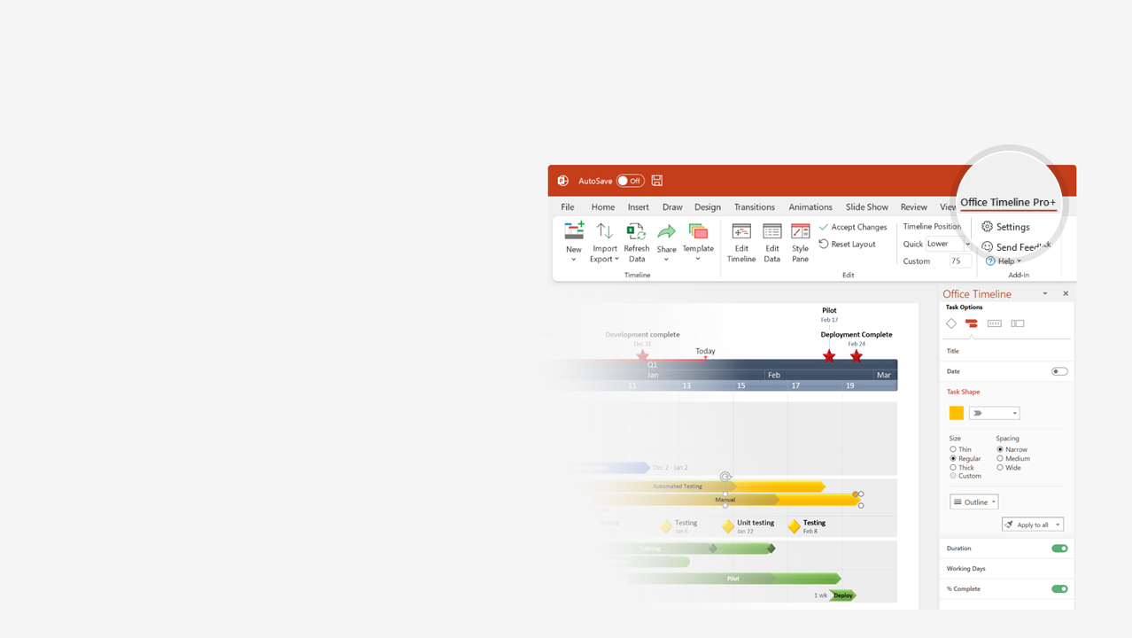

How to update this template in seconds
The Office Timeline add-in for PowerPoint will help you edit it with just a few clicks.
Get your free 14-day trial of Office Timeline here:
https://www.officetimeline.com/office-timeline/14-days-trial
Re-open this template, and create your impressive
PowerPoint visual in 3 easy steps:
1
Click the Edit Data button on the Office Timeline tab.
2
Use the Data and Timeline views to edit swimlanes, milestones and tasks.
3
Click Save to instantly update the template.

Slide 2
Task Tracker Template
6 days
May 28 - Jun 4
70%
Prepare
5 days
May 28 - Jun 1
50%
Develop Charter
1 day
Jun 1 - Jun 3
30%
Draft Scope
2 days
Jun 1 - Jun 4
Finalize Scope
0%
4 days
Jun 5 - Jun 9
Work Breakdown Structure
0%
7 days
Jun 8 - Jun 18
Plan Risks
0%
2 days
Jun 15 - Jun 18
Manage Quality
0%
3 days
Jun 17 - Jun 20
Update Project Tasks
0%
2 days
Jun 21 - Jun 24
Financial Adherence
0%
3 days
Jun 26 - Jun 28
Close Contracts
0%
4 days
Jun 25 - Jun 28
Schedule Adherence
0%
12 days
Jun 1 - Jun 18
50%
Plan
5 days
Jun 14 - Jun 20
Execute
0%
8 days
Jun 19 - Jun 28
Monitor
0%
4 days
Jun 26 - Jun 30
Close
0%
Project Sign-Off
Jun 27
2018
Week 1
2
3
4
5
2018
Today
Jun 4
Jun 12
Jun 24
Present Task Plan
Task Progress Review
Stakeholder Review

