Slide 1
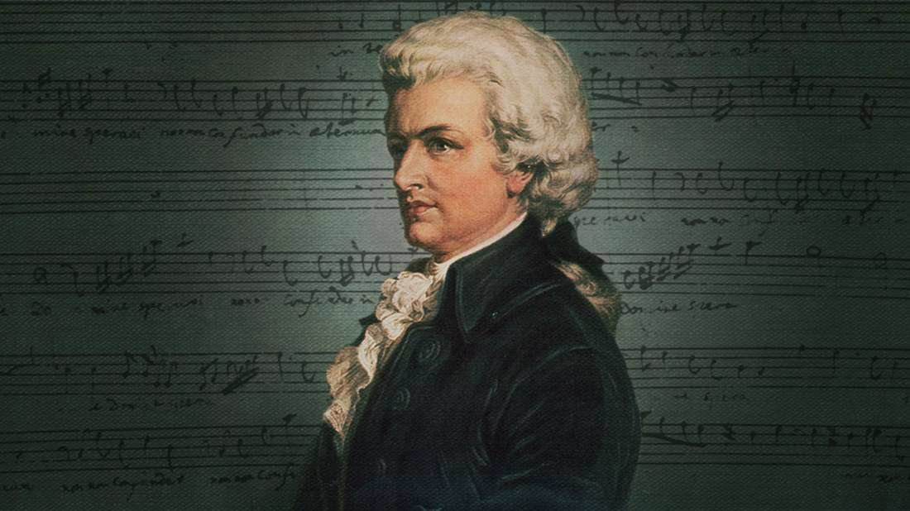
The Abduction from the Seraglio
1782
W. A. Mozart is born in Salzburg
Meets Johann Christian Bach
Begins freelance career
Cosi fan tutti
Jan 27, 1756
1764
1781
1790
Goes on tour in Italy
First musical compositions
1769
Travels to Paris in search of employment
The Marriage of Figaro
Dies from unknown illness
1761
1778
1786
Dec 5, 1791
1756
1756
1759
1762
1765
1768
1771
1774
1777
1780
1783
1786
1789
1791
Today
1760
1773
1782
1787
1791
Learns how to play the clavier at 4
Hired as court musician in Salzburg
Marries C. Weber
Don Giovanni
The Magic Flute
1764
1777
1784
His 1st symphony
Leaves the Salzburg court
Meets & befriends Joseph Haydn
1762
1770
1781
Has his first public recital
Accepted in the Accademia Filarmonica
Moves to Vienna, under Archbishop Colloredo's service
Life events
Important musical works

