Slide 1
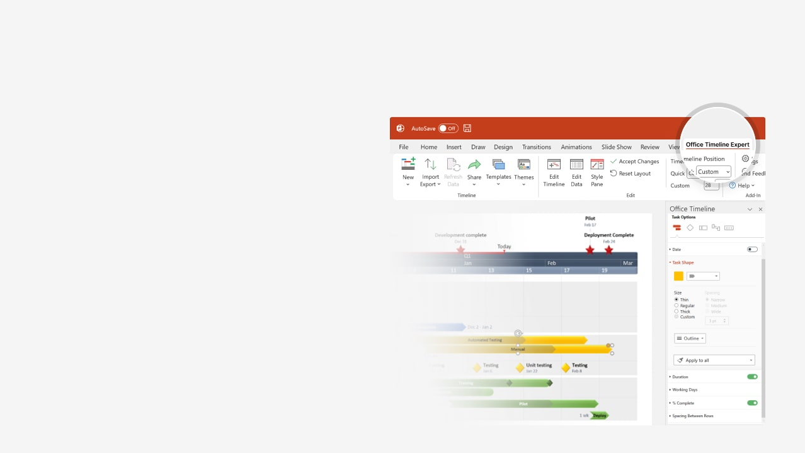

How to update this template in seconds
The Office Timeline add-in for PowerPoint will help you edit it with just a few clicks.
Get your free 14-day trial of Office Timeline here:
https://www.officetimeline.com/office-timeline/14-days-trial
Re-open this template, and create your impressive
PowerPoint visual in 3 easy steps:
1
Click the Edit Data button on the Office Timeline tab.
2
Use the Data and Timeline views to edit swimlanes, milestones and tasks.
3
Click Save to instantly update the template.

Slide 2

17 days
31 days
68%
35%
30%
25%
22%
17%
2025
2026
Today
Work Plan Template
Milestone 1
Milestone 4
Milestone 6
Milestone 8
May 10
Aug 12
Oct 30
Jan 30
Milestone 2
Milestone 3
Milestone 5
Milestone 7
Jun 7
Jul 21
Sep 20
Dec 20
May
Jun
Jul
Aug
Sep
Oct
Nov
Dec
2026
Task 1 Here
Fri 7/25/25
Sun 8/10/25
Task 2 Here
Fri 8/15/25
24 days
Sun 9/7/25
Task 3 Here
Fri 8/15/25
34 days
Wed 9/17/25
Task 4 Here
Mon 9/8/25
23 days
Tue 9/30/25
Task 5 Here
Sat 10/4/25
35 days
Fri 11/7/25
Task 6 Here
Tue 11/11/25
Thu 12/11/25

