Slide 1
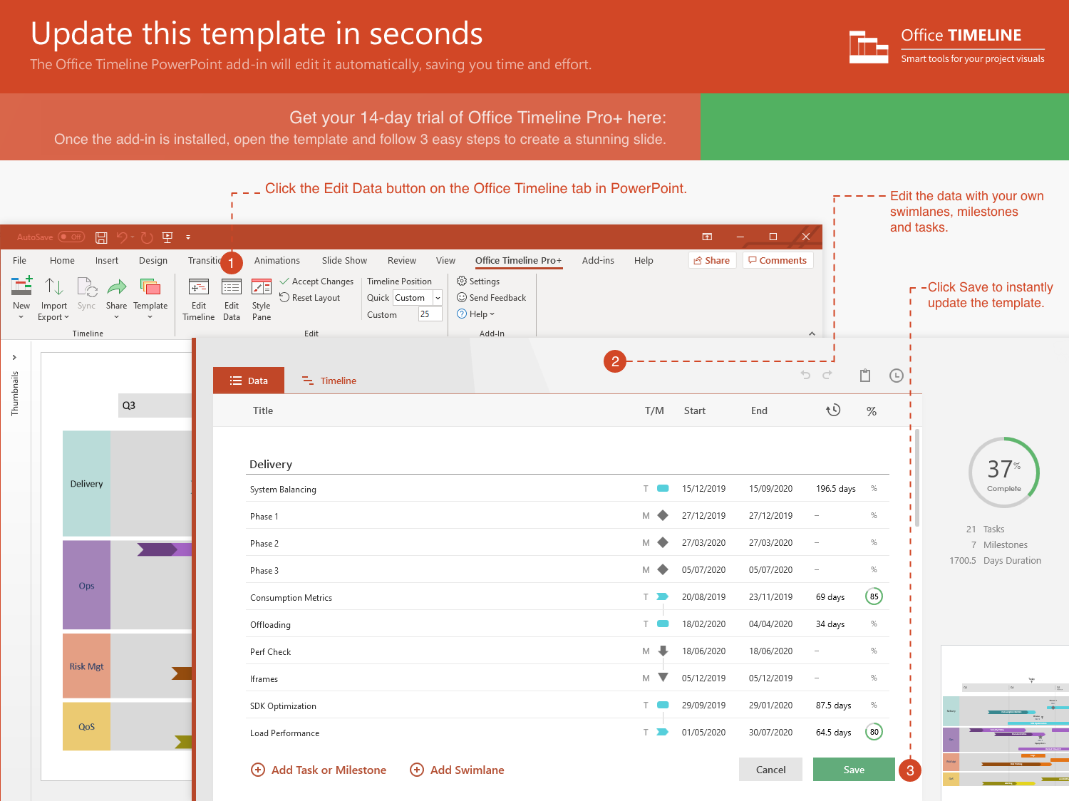
https://www.officetimeline.com/14-days-trial

Slide 2
2021
Today
2021
Feb
Mar
Apr
May
Jun
2021
35 days
Tue 2/23/21
RDP
Mon 4/12/21
1 day
Mar 24
RDP Phase1
1 day
Mar 31
RDP Phase2
1 day
Apr 12
RTM Phase1
34 days
Tue 2/16/21
API development
Sat 4/3/21
1 day
Mar 15
YCFG MVP
9 days
Mar 23 - Apr 3
API-Bundle
1 day
Mar 1
OC - Consolidation
1 day
Mar 8
RTM Phase2
34 days
Thu 4/1/21
YC development
Tue 5/18/21
5 days
May 2 - May 9
Date
1 day
Apr 6
DP API Bundle
0 days
Apr 10
DP Phase4
0 days
May 8
iPackage Phase1
27 days
Mon 5/10/21
YC1.1
Tue 6/15/21
1 day
May 17
DP Phase4 (RTM)
1 day
May 17
YC1.1 (RTM)
1 day
May 24
iPackage Phase2
1 day
May 27
DP Phase5
1 day
Jun 3
WND-CDG Phase 1
1 day
Jun 14
iPackage Phase3

