Slide 1
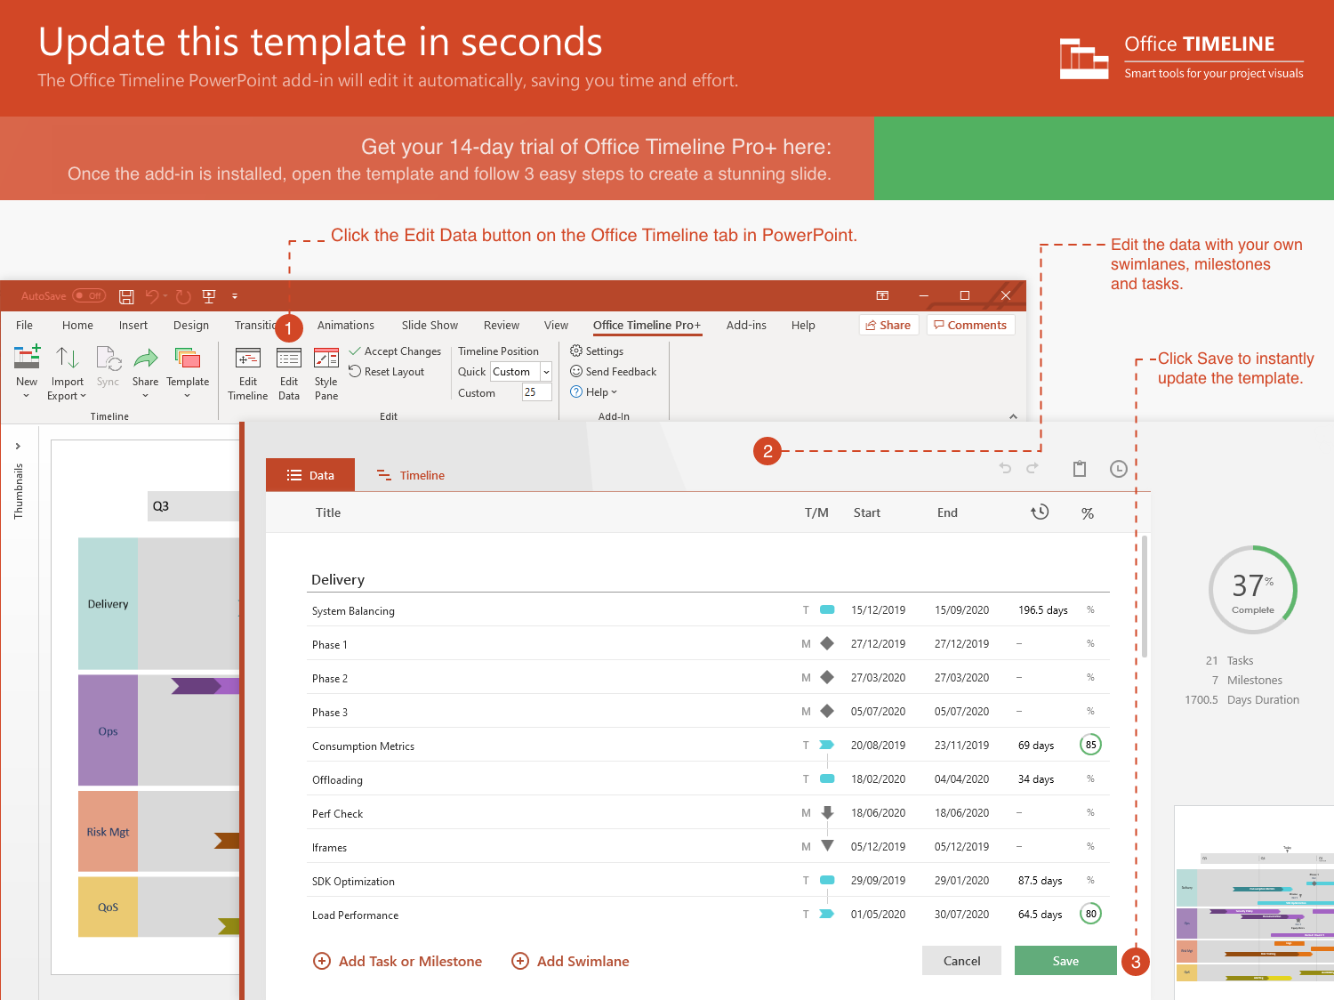
https://www.officetimeline.com/14-days-trial

Slide 2
35 days
Task 1
7/5 - 8/8
45 days
Task 2
7/30 - 9/12
47 days
Task 3
8/20 - 10/5
48 days
Task 4
8/29 - 10/15
40 days
Task 5
10/29 - 12/7
Milestone 2
Milestone 4
Aug 15
Feb 15
2021
Jun
Jul
Aug
Sep
Oct
Nov
Dec
2022
Feb
2022
Today
Jun 18
Milestone 3
Feb 28
Milestone 1
Nov 10
Milestone 5

