Slide 1
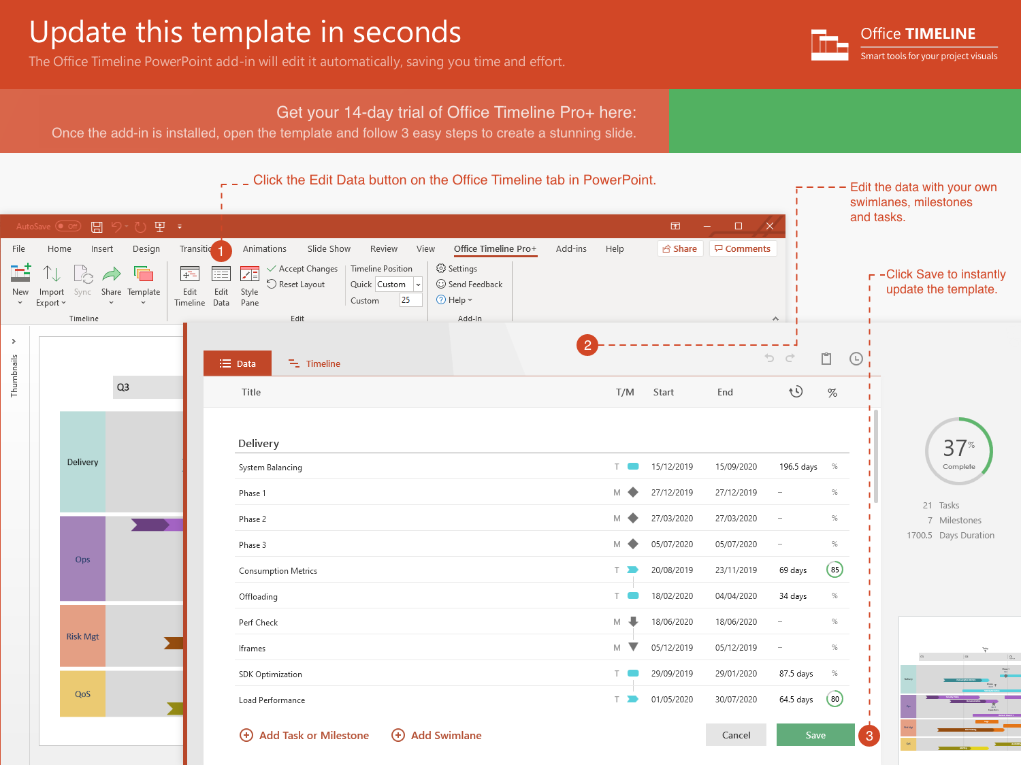
https://www.officetimeline.com/14-days-trial

Slide 2
Migration Plan
Migration Plan
Notification
Notification
Aug 20 - Sep 23
Jul 29 - Aug 30
Sep 21 - Oct 11
Aug 21 - Sep 18
Jun 3 - Jul 15
Jun 3 - Jun 24
Jun 30 - Aug 1
Oct 1 - Oct 15
Awareness
15.8 days
22.1 days
23.9 days
22.9 days
14.9 days
10.6 days
31 days
20 days
Blank
Blank
Blank
Blank
Blank
Blank
Blank
Sep 13
Jul 31
Jun 26
Sep 30
Jun 30
Jul 26
Aug 26
Jul 19
Aug 13
Jul 17
Jul 21
Aug 11
Aug 15
Sep 25
Aug 18
Oct 13
Nov 18
Sep 20
Oct 17
Sep 28
2021
Aug 4
Aug 8
Aug 4
Aug 8
Sep 7
Sep 5
Sep 9
Aug 2
Sep 1
M5
2021
IT Migration Swimlane Chart Template
Today
June
July
August
September
October
November
Key
Milestones
Impact Analysis
Jul 17
Migration Plan
Identify Stakeholders
Planning Deep Dives
Workshop Invites
Workshop Invites
Workshop Invites
Workshops
Small Migrations Workshops
Digital Migration Workshops
Asset Migration Workshops
Small Migrations
Communication
Reminder
Notification
Migration
Go Live!
Digital Migration
Communications
Reminder
Migration
Go Live!
Notification
Asset Migration
Communications
Reminder
Notification
Migration
Go Live!

