Slide 1
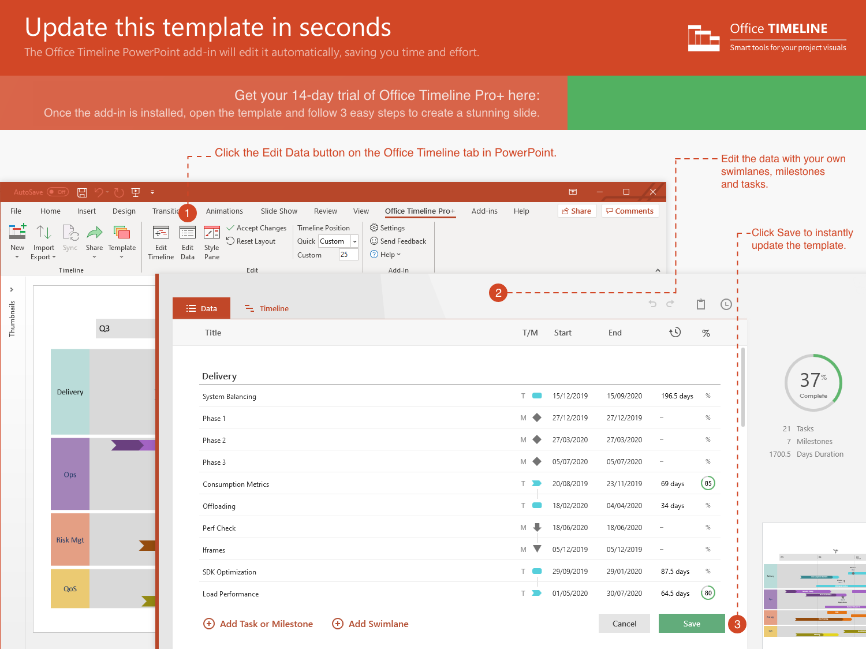
https://www.officetimeline.com/14-days-trial

Slide 2
Planning R2 Begin
Planning R2 Begin
Planning R2 Begin
May 11 - Jun 30
Jun 30 - Aug 17
Aug 11 - Oct 21
Mar 1 - May 16
Aug 18 - Oct 4
Apr 1 - May 13
Apr 1 - Oct 21
Feb 10
Aug 14
Jan 1 - Mar 6
Feb 1 - Mar 25
Oct 1 - Dec 22
5/17 - 7/20
Mar 1 - Apr 1
145.5 days
May 1
Aug 4
46.5 days
36.5 days
34.5 days
33.5 days
30.5 days
23.5 days
46 days
50.7 days
57.6 days
38.5 days
55 days
Jun 26
Oct 19
May 29
Jun 19
Jul 10
Aug 1
Oct 2
2021
2021
Today
Product Development Roadmap template
Project Kickoff
Jan 25
Executive Review
Release Candidate
Mar 10
Oct 1
Executive Decision
Beta Release
Final Release
Mar 21
Jun 30
Oct 20
2021
Jan
Feb
Mar
Apr
May
Jun
Jul
Aug
Sep
Oct
Nov
Dec
Assemble Resources
Working Plans
Plan
Subcontractor Selection
Helpdesk Content Plan
Planning R2 Begin
Performance Validation
Test Complete
Monitoring
Phase Sync
Load Balance
Test
Integration I
Integration II
Integration III
Prototype
Alpha Build
Development Phase I
Develop
Development Phase II
RC Pilot Deployment
RTW Deployment
V2 Development Begins
Mon, Nov 1, 2021
WW Launch Event
Launch
Beta Blog Launch
July 4, 2021
Gartner Analyst Review
November 1, 2021
Press Release
July 16, 2021
Public Website Live
November 1, 2021

