Slide 1
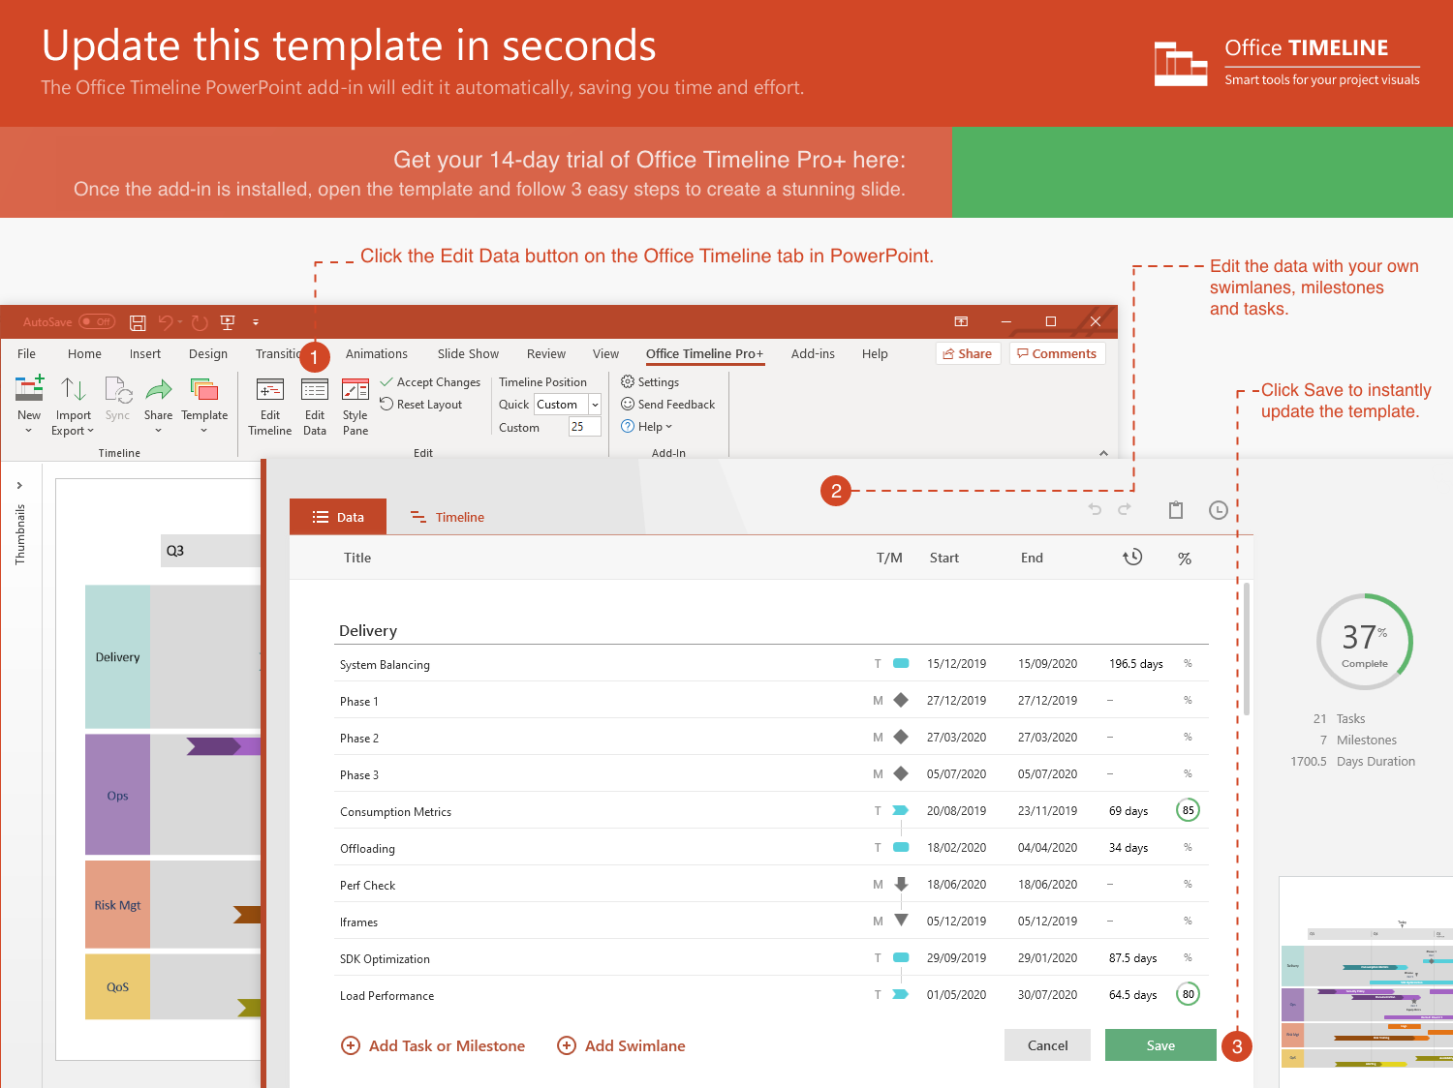
https://www.officetimeline.com/14-days-trial

Slide 2
Minimal Prototype
Release Web Prototype
9/30/21
3/1/22
Kick-Off
Submission
Online Testing
Release
5/1/21
11/25/21
5/20/22
3/15/23
2021
Apr
Jul
Oct
2022
Apr
Jul
Oct
2023
Apr
2023
Today
10/30/21
7/22/22
1/1/23
Integration
Validation
Exec Review
141 days
System Design
80%
5/21 - 11/21
73 days
Coding
73%
11/21 - 3/22
128 days
Code Improvements
56%
3/22 - 8/22
43 days
Stabilization
20%
8/22 - 10/22
77 days
Integration with Website
15%
8/22 - 11/22
97 days
User Acceptance
10/22 - 2/23
105 days
Documentation
1/23 - 5/23

