Slide 1
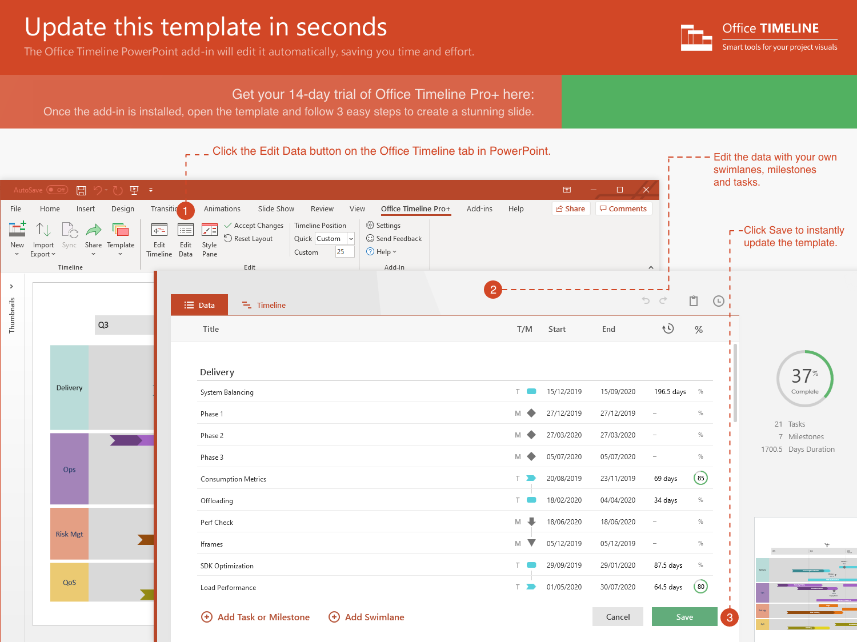
https://www.officetimeline.com/14-days-trial

Slide 2
19 days
27 days
17 days
35 days
18 days
24 days
19 days
22 days
13 days
11 days
5 days
2021
2021
Today
Feb 12 - Mar 10
100%
Scope
Feb 15 - Mar 23
76%
Project Resources
Mar 1 - Mar 23
100%
Analysis
Mar 23 - May 10
70%
Design
May 10 - May 16
37%
Draft Specs
Apr 27 - May 20
40%
Development
May 9 - Jun 10
20%
Coding
May 17 - Jun 10
75%
UI
May 24 - Jun 22
15%
Testing
Jun 1 - Jun 17
0%
Training
May 29 - Jun 14
10%
Documentation
Project Sponsor
Analysis Complete
Functional Design Complete
Project Status Report
Feb 15
Mar 23
May 10
Jun 14
Feb
Mar
Apr
May
Jun

