Slide 1
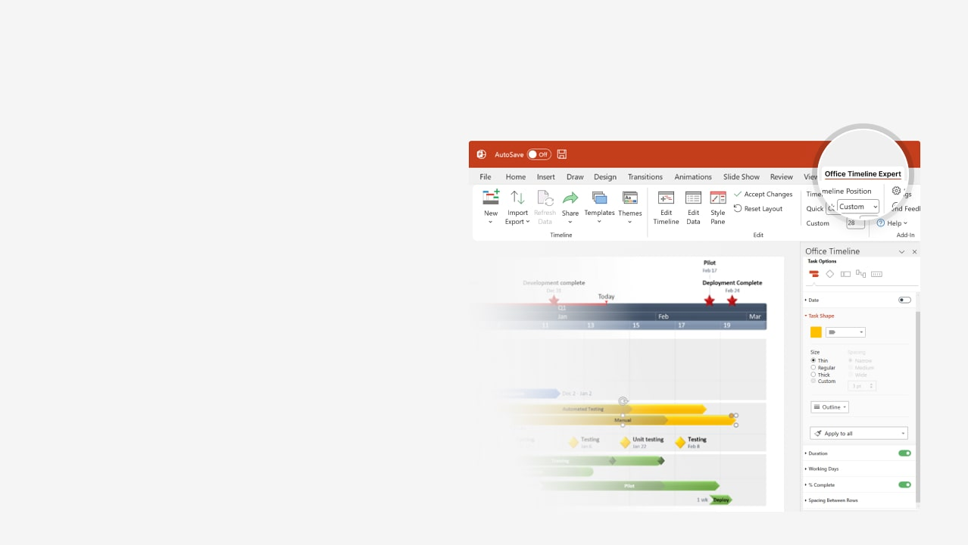
How to update this template in seconds
The Office Timeline add-in for PowerPoint will help you edit it with just a few clicks.
Get your free 14-day trial of Office Timeline here: https://www.officetimeline.com/office-timeline/14-days-trial Re-open this template, and create your impressive PowerPoint visual in 3 easy steps:
1
Click the Edit Data button on the Office Timeline tab.
2
Use the Data and Timeline views to edit swimlanes, milestones and tasks.
3
Click Save to instantly update the template.

Slide 2
Visual Schedule
Outfitting Afloat
6.8 weeks
02.04 - 03.23
Mooring & Safety Gear
01.27 - 02.03
Machinery & Electrical Installation
5.9 weeks
12.18 - 01.29
Coating
12.10 - 12.18
Block Assembly
2.8 weeks
11.24 - 12.13
Engine Room & Accommodation
6.8 weeks
10.07 - 11.24
Hatch & Superstructure
2.2 weeks
09.18 - 10.03
Steel Profiles
3.3 weeks
08.30 - 09.22
Engineering
3.7 weeks
08.05 - 08.31
Control Systems
Dec 26
Sea Trial 1
Known Risk 1
Known Risk 2
Launch
Sep 20
Dec 18
Mar 11
Mar 31
Project Kick-Off
Adjusters
Known Risk 3
Known Risk 4
Aug 4
Oct 26
Feb 7
Mar 11
Week 1
6
11
16
21
26
31
Aug 28
Nov 25
Jan 21
Mar 24
Steel Cutting
All Blocks Complete
Navigation Installation Done
Sea Trial 2
Revisions
Schedule Revision
Sep 10
Schedule Revision
Nov 13
Schedule Revision
Jan 19

