Slide 1
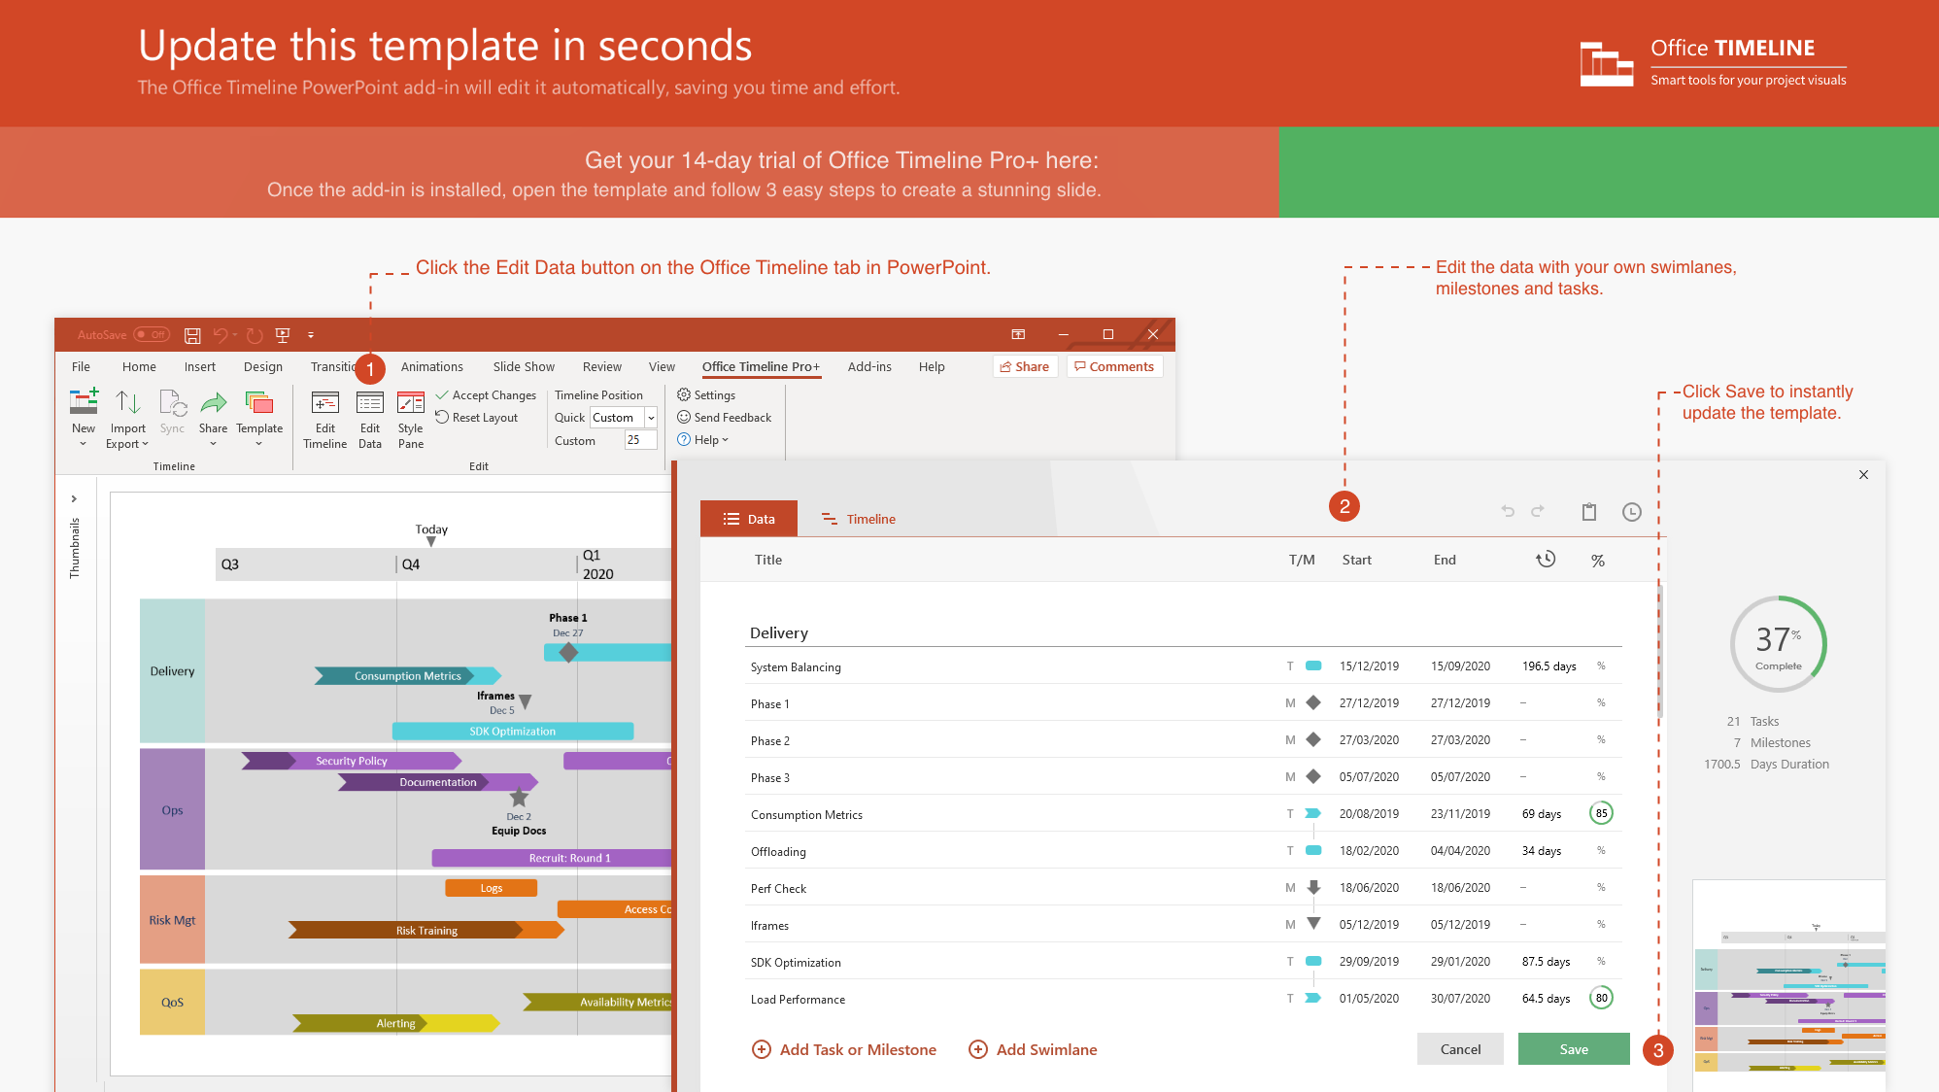
https://www.officetimeline.com/14-days-trial

Slide 2
Product Roadmap template
Executive Review
Release Candidate
Mar 10
Oct 1
Project Kickoff
Executive Decision
Beta Release
Final Release
Jan 25
Mar 21
Jun 30
Oct 20
2019
Jan
Feb
Mar
Apr
May
Jun
Jul
Aug
Sep
Oct
Nov
Dec
Assemble Resources
Working Plans
Plan
Subcontractor Selection
Helpdesk Content Plan
Planning R2 Begin
Performance Validation
Test Complete
Monitoring
Phase Sync
Load Balance
Test
Integration I
Integration II
Integration III
Prototype
Alpha Build
Development Phase I
Develop
Development Phase II
RC Pilot Deployment
RTW Deployment
V2 Development Begins
Fri, Nov 1, 2019
WW Launch Event
Launch
Beta Blog Launch
July 4, 2019
Gartner Analyst Review
November 1, 2019
Press Release
August 2, 2019
Public Website Live
November 1, 2019

