Slide 1
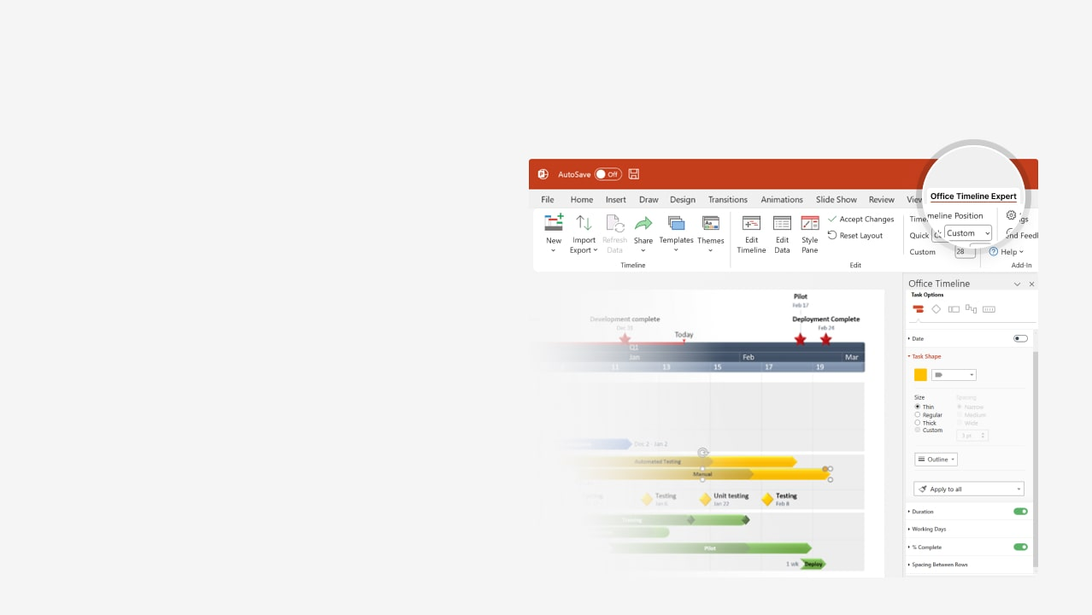
How to update this template in seconds
The Office Timeline add-in for PowerPoint will help you edit it with just a few clicks.
Get your free 14-day trial of Office Timeline here: https://www.officetimeline.com/office-timeline/14-days-trial Re-open this template, and create your impressive PowerPoint visual in 3 easy steps:
1
Click the Edit Data button on the Office Timeline tab.
2
Use the Data and Timeline views to edit swimlanes, milestones and tasks.
3
Click Save to instantly update the template.

Slide 2
2024
2029
Action plan timeline
End of Phase 3 Review
End of Phase 2 Review
Oct 16
End of Phase 1 Review
Jun 18
May 27
Today
2024
2025
2026
2027
2028
2029
Milestone 1
Milestone 2
Phase 1
Mar 8
Jan 8
Sep 1 - May 24
90.2 wks
FIRST PHASE description
Milestone 4
Milestone 3
Milestone 5
Phase 2
Dec 31
Aug 3
Feb 17
Jul 24 - Jun 15
99 wks
SECOND PHASE description
Milestone 6
Milestone 7
Phase 3
Aug 6
May 30
Dec 18 - Oct 13
95 wks
THIRD PHASE description

