Slide 1
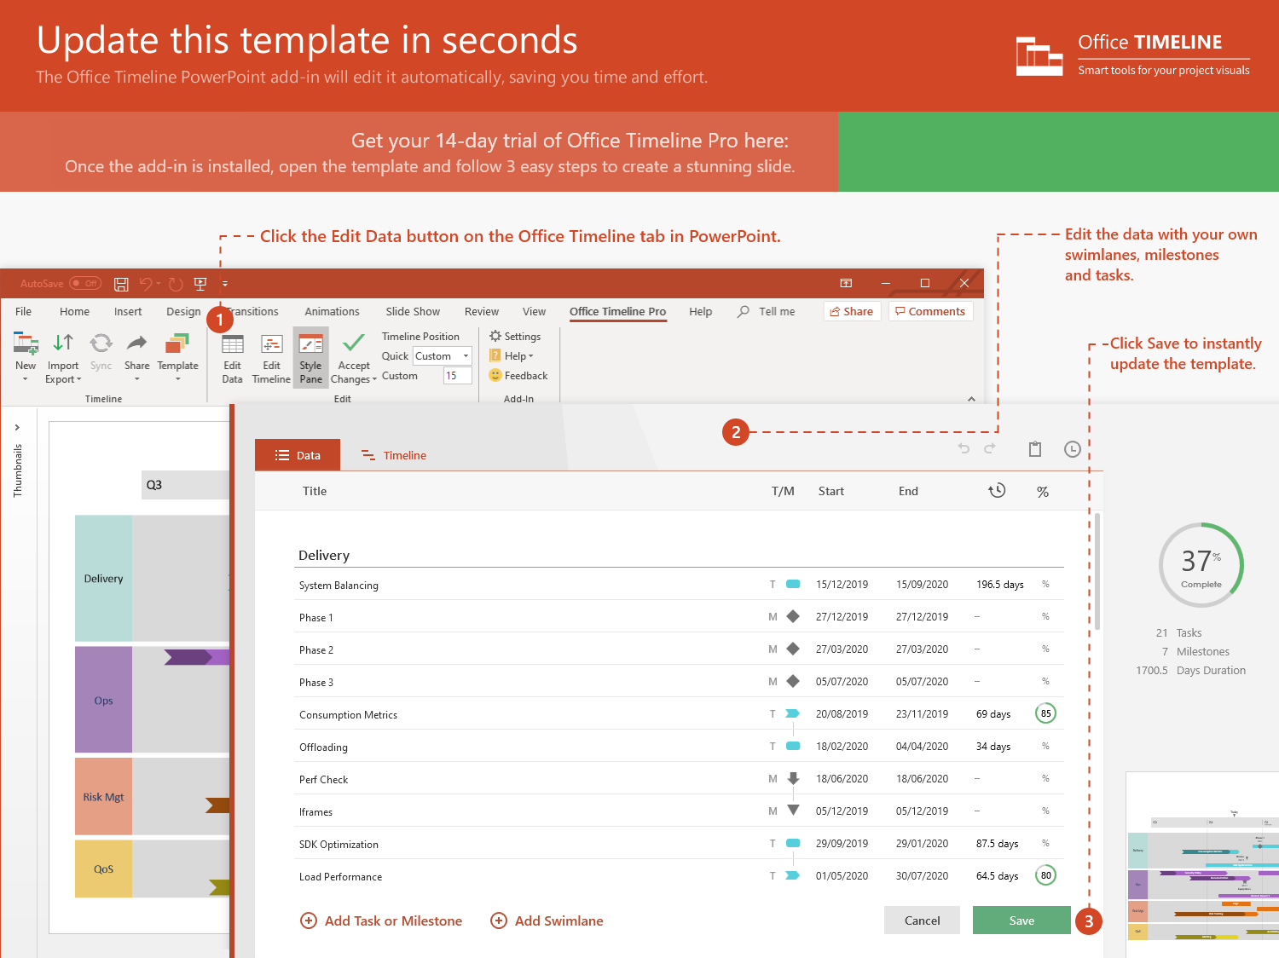
https://www.officetimeline.com/14-days-trial

Slide 2
Winner named
Mark picks me up
My speech time
5:00 pm
9:30 am
1:45 pm
Jul 24
7 am
8 am
9 am
10 am
11 am
12 pm
1 pm
2 pm
3 pm
4 pm
Jul 24
Work out
Today
7:30 a
0 mins
8:45 a
Get ready
8:50 a
0 mins
9:25 a
Drive
9:30 a
0 mins
10:15 a
Rehearsal
10:30 a
0 mins
11:30 a
Final tweaks
11:30 a
0 mins
12:00 p
Candidates' lunch
12:00 p
0 mins
1:00 p
Candidates' assembly
1:00 p
0 mins
5:00 p
Balloting
3:30 p
0 mins
4:00 p
Ballot count
4:00 p
0 mins
4:45 p

