Slide 1
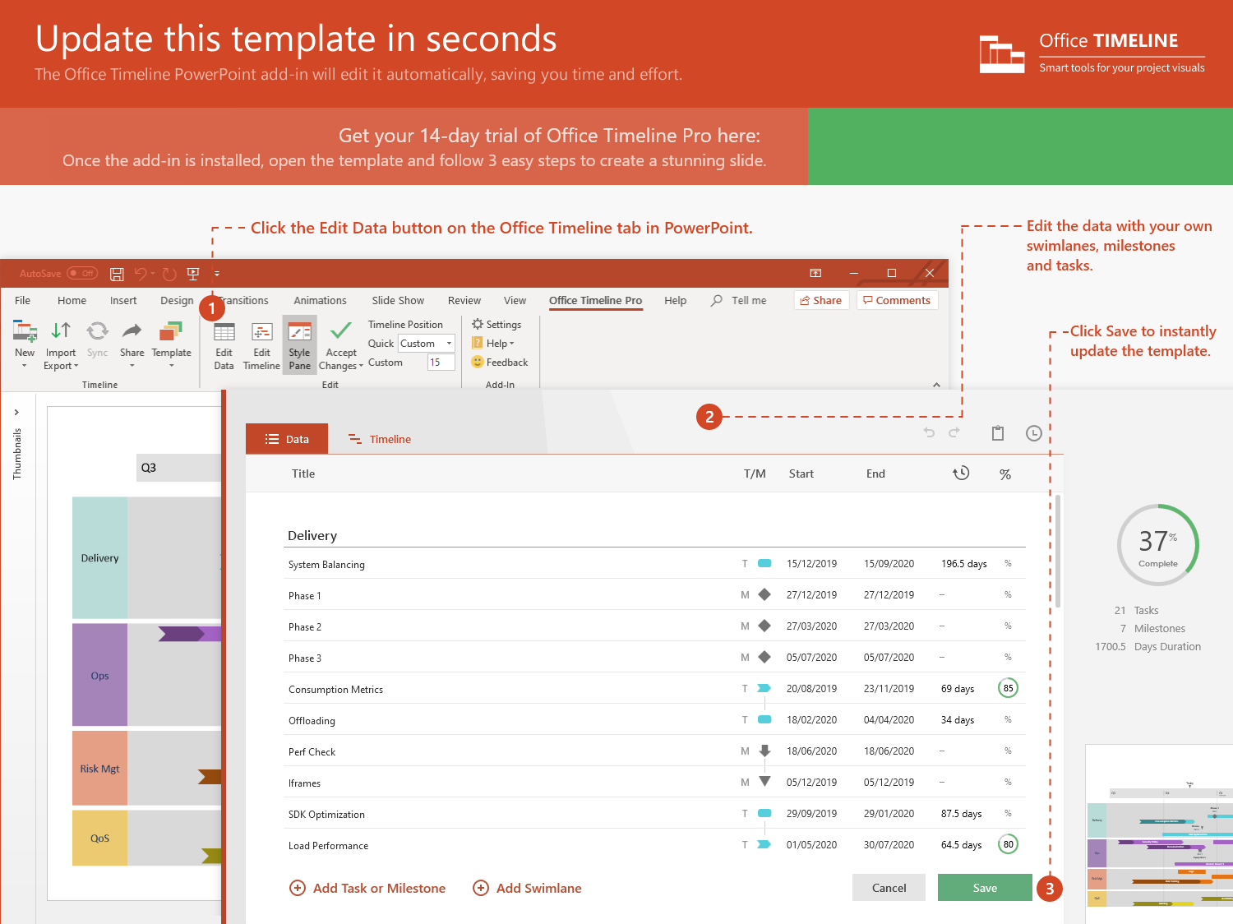
https://www.officetimeline.com/14-days-trial

Slide 2
Mitigation equipment sent
16:03
Mitigation personnel depart
16:06
Leak begins
Mitigation personnel arrive
13:16
16:52
Declared Code Red
Mitigation equipment sent
13:22
17:07
Response preparations
Response base up
13:31
17:47
Vanguard team dispatched
Mop-up and recovery begins
13:43
18:05
Aug 11
13:00
14:00
15:00
16:00
17:00
18:00
Aug 11
Today
1:22 PM
Sector D Incident Response Time
5:47 PM
265 minutes

