Slide 1
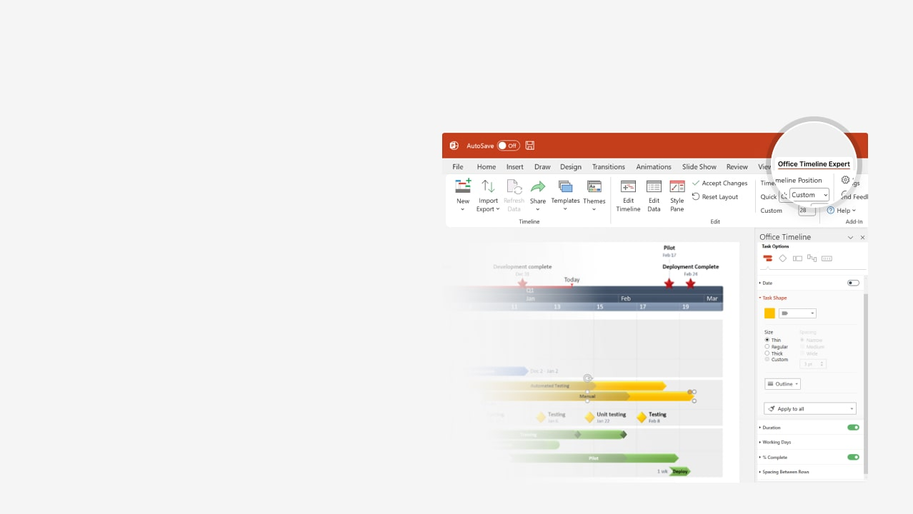
How to update this template in seconds
The Office Timeline add-in for PowerPoint will help you edit it with just a few clicks.
Get your free 14-day trial of Office Timeline here: https://www.officetimeline.com/office-timeline/14-days-trial Re-open this template, and create your impressive PowerPoint visual in 3 easy steps:
1
Click the Edit Data button on the Office Timeline tab.
2
Use the Data and Timeline views to edit swimlanes, milestones and tasks.
3
Click Save to instantly update the template.

Slide 2
2025
2025
Today
Marketing Plan Template
Milestone 1
Milestone 7
May 14
Dec 18
Q2
Q3
Q4
May
Jun
Jul
Aug
Sep
Oct
Nov
Dec
Day 1
21
41
61
81
101
121
141
161
181
201
Milestone 2
Milestone 3
Jun 7
Aug 12
Phase 1
Task 1
47 days
Task 3
49 days
Milestone 5
May 18 - Jul 3
Jul 19 - Sep 5
Nov 4
Task 2
45 days
Jun 17 - Jul 31
Milestone 4
Milestone 6
Sep 25
Nov 15
Phase 2
Task 4
45 days
Task 6
35 days
Sep 5 - Oct 19
Nov 7 - Dec 11
Task 5
35 days
Oct 4 - Nov 7

