Slide 1
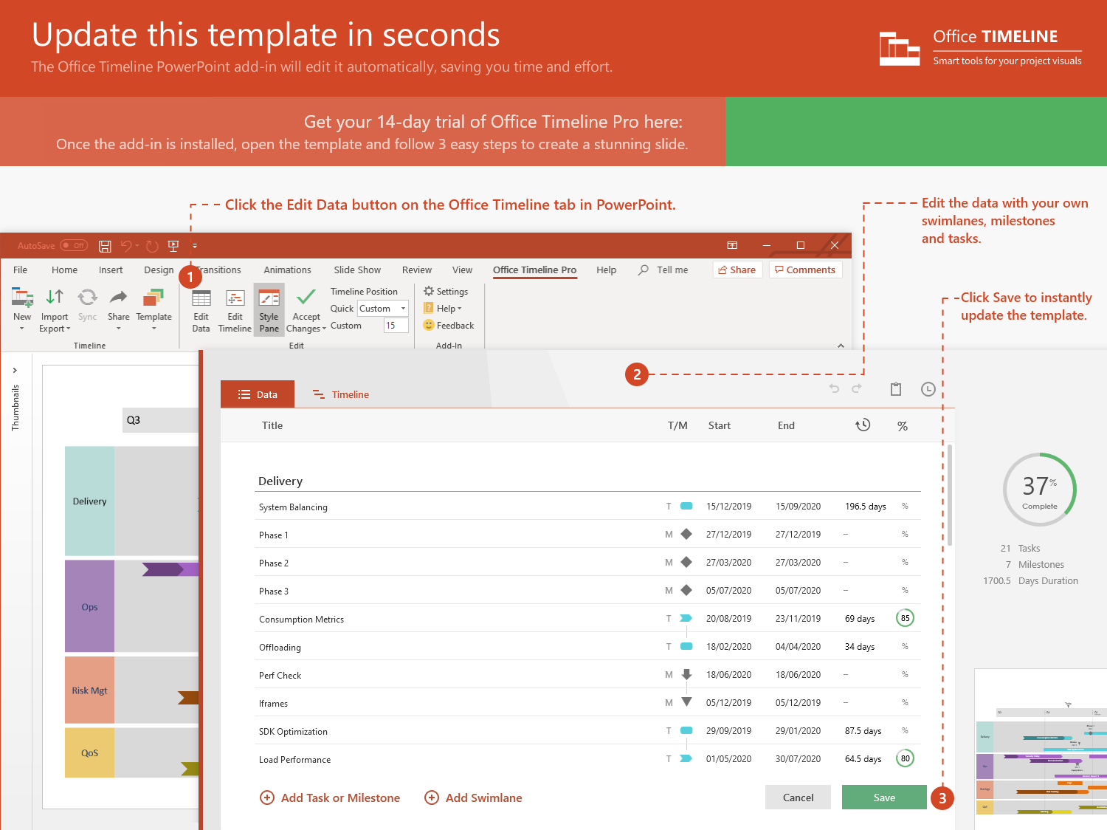
https://www.officetimeline.com/14-days-trial

Slide 2
Jun 1 - Aug 6
9.8 wks
Phase 2 Here
Jun 1 - Sep 1
13.4 wks
Phase 3 Here
Oct 1 - May 30
34.4 wks
Phase 6 Here
Jan 1 - Jun 30
25.8 wks
Phase 7 Here
Sep 1 - Oct 15
6.4 wks
Phase 9 Here
Sep 30 - Dec 31
13.2 wks
Phase 10 Here
2021
Week 1
9
17
25
33
41
49
57
65
73
81
2022
Today
May 30
Jan 1
Target 1
Target 3
Oct 1
Jul 1
Oct 15
Target 2
Target 4
Target 5
May 1 - Jun 22
7.4 wks
Phase 1 Here
Aug 1 - Dec 29
21.6 wks
Phase 4 Here
Oct 1 - May 30
34.4 wks
Phase 5 Here
May 30 - Sep 30
18 wks
Phase 8 Here

