Slide 1
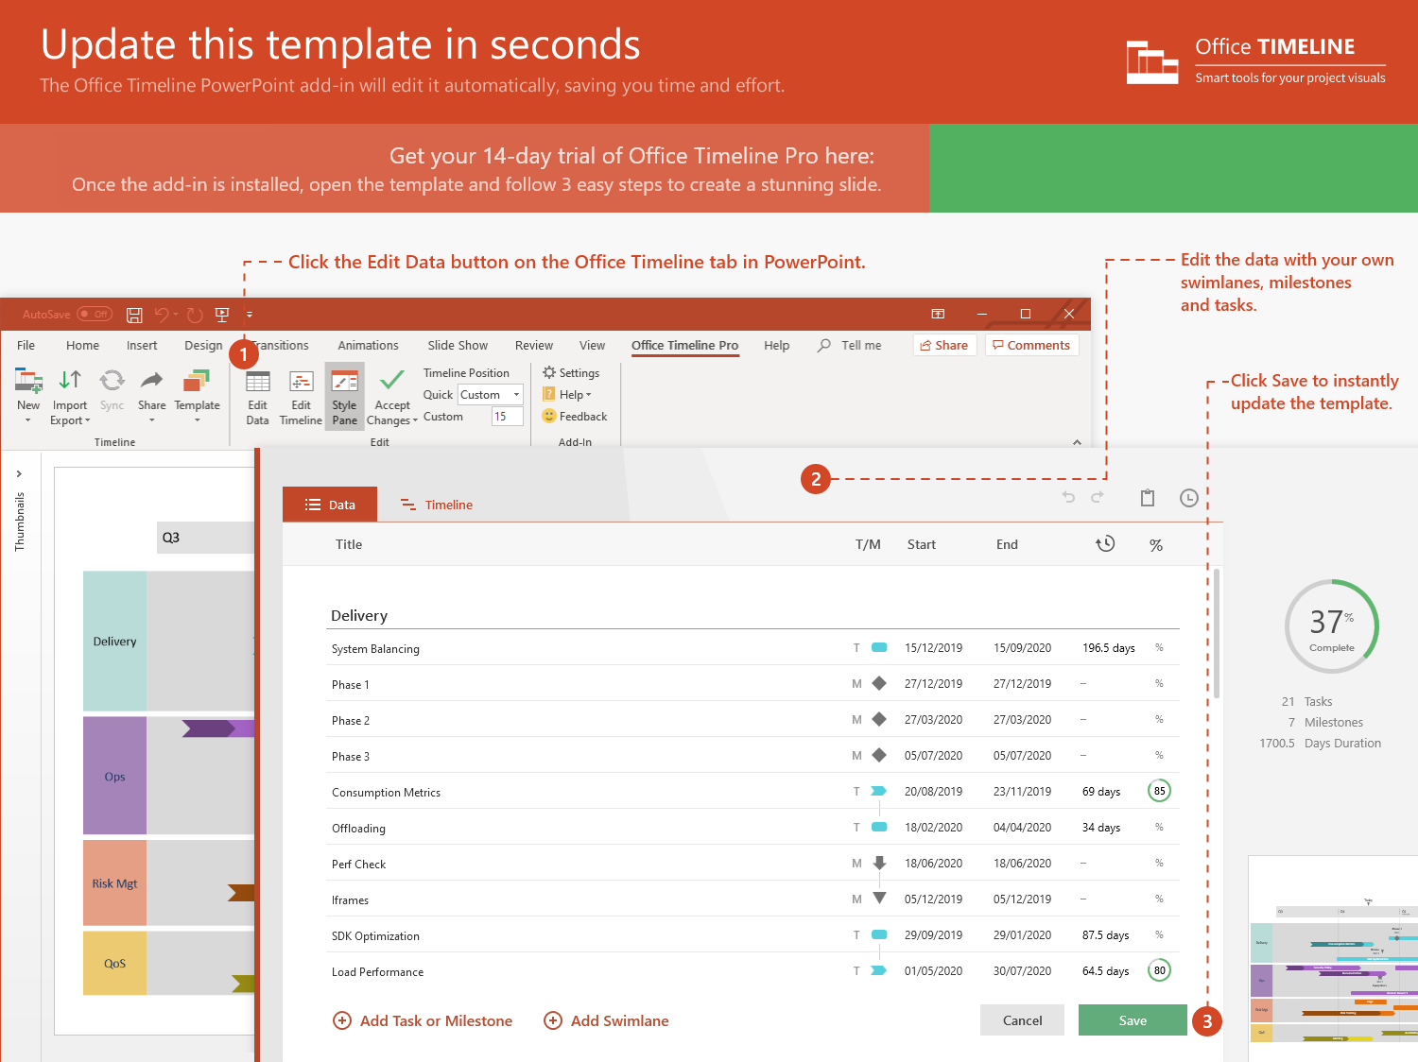
https://www.officetimeline.com/14-days-trial

Slide 2
May 31 - Jun 10
Jun 13 - Jun 22
Jun 14 - Jun 18
Jun 15 - Jun 20
Jun 19 - Jun 27
Jun 15 - Jun 22
Jun 22 - Jun 26
Jun 26 - Jun 30
May 30 - Jun 3
Jun 5 - Jun 15
Jun 1 - Jun 13
Jun 1 - Jun 7
2021
2021
Today
4 days
0%
Create project charter
9 days
0%
Process definition
5 days
0%
Define deliverables
7 days
0%
Monitoring Phase
9 days
0%
Validate data collection
7 days
0%
Analysis
5 days
0%
Program capability
4 days
0%
Performance levels
5 days
0%
Review work breakdown
6 days
0%
Adjustments Phase
4 days
0%
Triage causes
3 days
0%
Monitoring
Metrics 1
Metrics 2
Operating snapshot
Metrics 3
Jun 12
Jun 20
Jun 26
Jul 2
Day 1
6
11
16
21
26
31
May 29
Jun 7
Jun 16
Jun 22
Jun 28
Identify client issues
Performance thresholds
Statistical review
Adjustments Complete
Implementation

