Slide 1
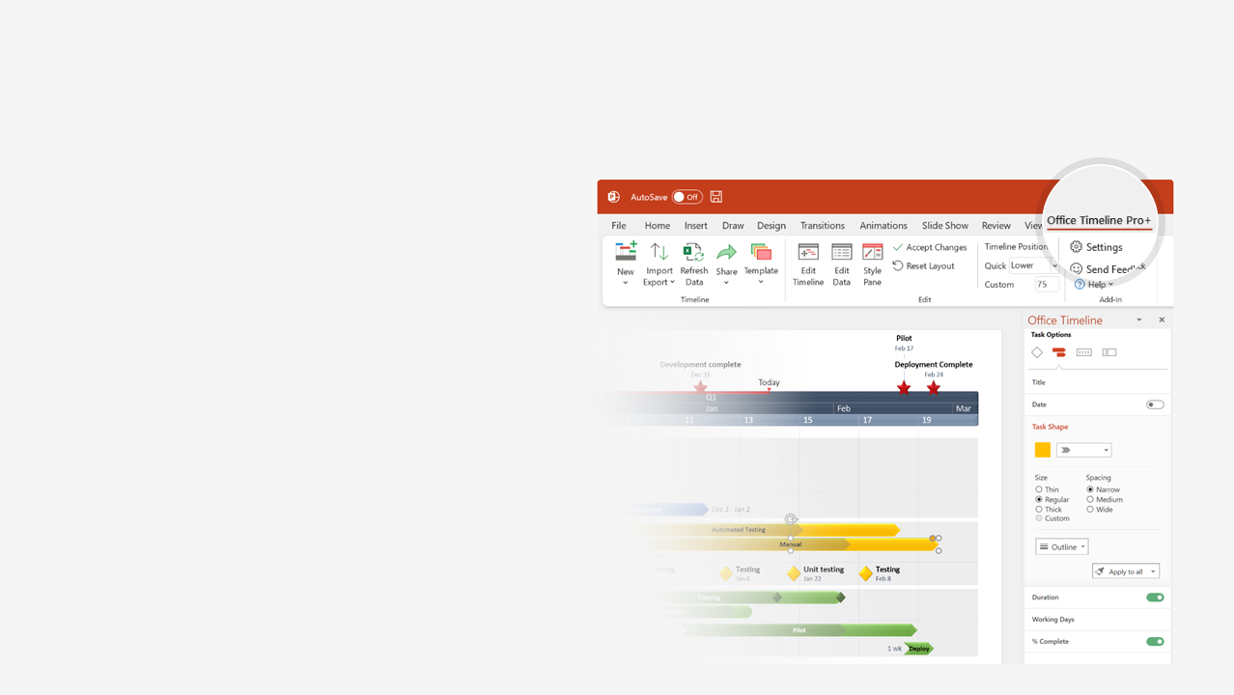
How to update this template in seconds
The Office Timeline add-in for PowerPoint will help you edit it with just a few clicks.
Get your free 14-day trial of Office Timeline here: https://www.officetimeline.com/office-timeline/14-days-trial Re-open this template, and create your impressive PowerPoint visual in 3 easy steps:
1
Click the Edit Data button on the Office Timeline tab.
2
Use the Data and Timeline views to edit swimlanes, milestones and tasks.
3
Click Save to instantly update the template.

Slide 2
131 days
41 days
54 days
76 days
Apr 25
Jun 17
Aug 15
Dec 4
2021
2023
Today
Q4
Q1
Sales Plan template
Major Milestone
Major Milestone
Major Milestone
Mar 31
Jun 30
Sep 30
Q1
Q2
Q3
Q4
Dec
Feb
Apr
Jun
Aug
Oct
Dec
52
6
12
18
24
30
36
42
48
Task 1
Jan 1 - Feb 28
Phase 1
Milestone 1
Milestone 2
Milestone 3
Jan 15
Feb 27
Apr 10
Phase 2
Milestone 4
Mar 1 - May 15
Task 2
Milestone 5
May 25
Phase 3
Milestone 6
Milestone 7
Apr 15 - Oct 15
Task 3
Phase 4
Milestone 8
Sep 15 - Dec 29
Task 4

