Slide 1
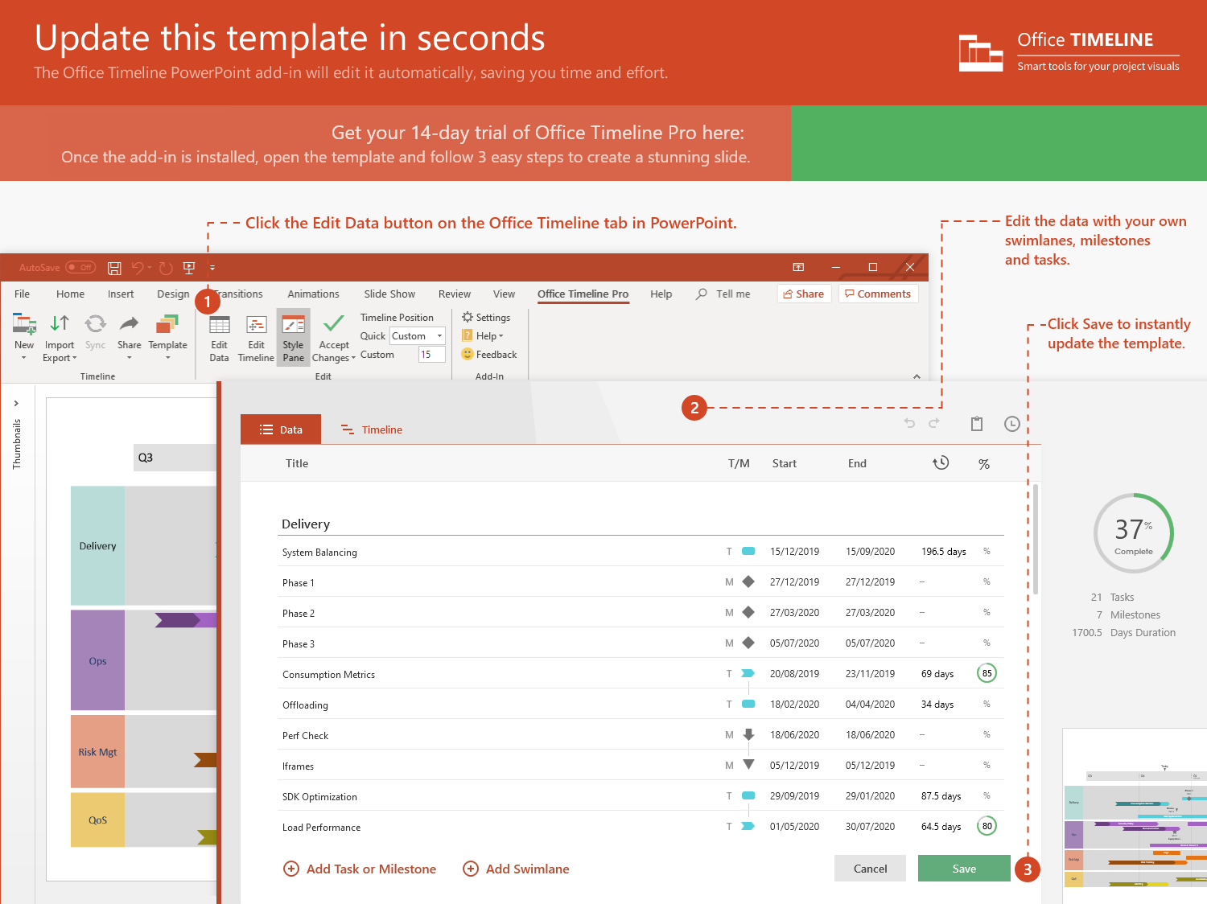
https://www.officetimeline.com/14-days-trial

Slide 2
Kickoff Meeting
KPIs Defined
Jan 28 - Mar 31
Jul 13 - Sep 30
Oct 21 - Dec 25
Jan 31 - Mar 29
Jan 2 - Mar 31
Jun 4 - Jul 11
Feb 23 - Apr 7
Apr 2 - Jun 10
Jul 7 - Sep 14
Aug 3 - Oct 28
Sep 1 - Oct 21
Oct 13
May 27
Aug 12
Jan 16 - Apr 7
Apr 2 - May 4
Jun 5 - Aug 21
Apr 2 - Jun 2
Apr 1 - Sep 1
Mar 22
Aug 4
Oct 9
62.8 days
44.8 days
56.4 days
43.5 days
30.4 days
62.2 days
46.9 days
2021/Mar
2021/Jul
2021/Sep
2021/Dec
22.6 days
55 days
57.9 days
26 days
50 days
50 days
7.1 wks
Dec 20
Dec 21
Jan 16
Mar 31
Mar 31
2021
Jun 7
75%
75%
75%
75%
Today
2021
Swimlane Diagram template
Q1 Review
Q2 Review
Q3 Review
Q4 Review
Q1
Q2
Q3
Q4
Vision
100%
Planning
Objectives
100%
100%
Goals
Strategic Intent
Sales Budget
Beta + Release Plans
Competitor Review
Market Analysis
SWOT
Strategy
Price List (Hypothesis)
Final Price List
Business Model
Price Research
Objectives
Sales Trends Analysis
Service Development
Alpha
Private Beta
Public Beta
Staging
Go Live!
8.1 wks
22 wks
May 20
Jun 30
Aug 10
Nov 15
Dec 20
75%
Product Roadmap
Development
RC
Release to Web
Business Intelligence
Service Metrics
Quality Metrics
Service Dashboard
Real-time Analytics
Sales Dashboard
Conversion Metrics
Real-time Reporting

