Slide 1
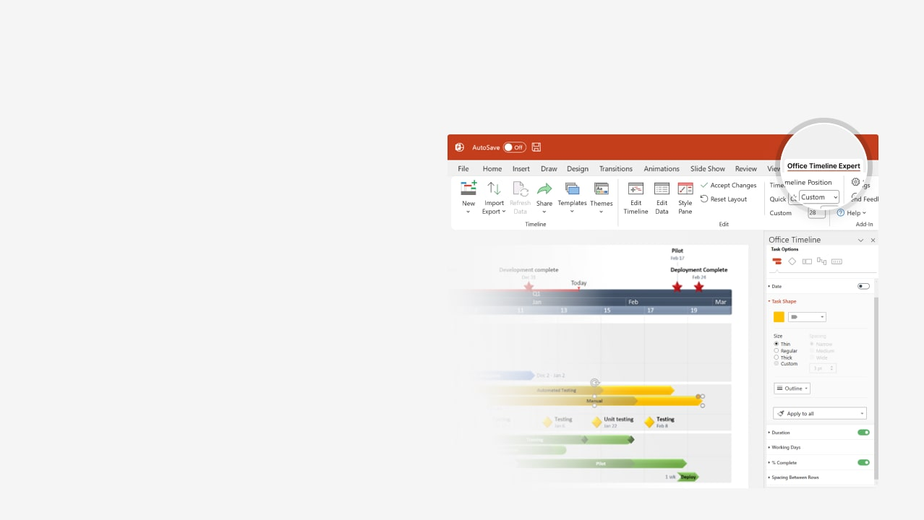
How to update this template in seconds
The Office Timeline add-in for PowerPoint will help you edit it with just a few clicks.
Get your free 14-day trial of Office Timeline here: https://www.officetimeline.com/office-timeline/14-days-trial Re-open this template, and create your impressive PowerPoint visual in 3 easy steps:
1
Click the Edit Data button on the Office Timeline tab.
2
Use the Data and Timeline views to edit swimlanes, milestones and tasks.
3
Click Save to instantly update the template.

Slide 2
Task List Template
Target 1
Target 2
Target 3
Jun 27
Oct 1
Jan 17
2024
2025
Jun
Aug
Oct
Dec
Feb
Apr
Jun
Aug
Oct
Dec
Target 4
Target 5
Sep 29
May 31
Team 1
Task 1 Here
Task 2 Here
Task 3 Here
Jul 25 - Sep 29
Sep 29 - May 31
May 31 - Oct 1
Target 6
Target 7
Target 8
Jul 19
Feb 1
Oct 1
Team 2
Task 4 Here
Task 5 Here
Jun 5 - Feb 1
Feb 1 - Jan 17
Task 6 Here
Nov 23 - Mar 30
Target 9
Dec 29
Team 3
Task 7 Here
Task 8 Here
Aug 1 - Dec 29
Dec 29 - Jun 27

